Slide 1
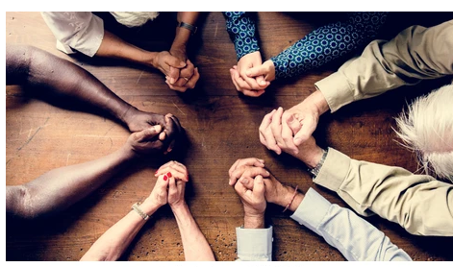
Monday 28th June
LC: Can I understand what temptation is?

Slide 2
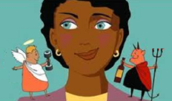
What is temptation?
Temptation is when we feel that we want something or want to do something even though we know we shouldn’t.
For example: I was tempted to eat my friend’s cake even though I knew it was greedy.

Slide 3
Think of as many different things as you can that you can be tempted by.

Slide 4
Different types of temptation
It is not always things that tempt us. We can also be tempted to think, act and say things that we know are wrong. Draw this table and add at least two more words that tempt you in each section.
objects
actions
Staying in bed all day
Too much cake
Thoughts
speech
Shouting out in class
Wishing someone would get hurt

Slide 5
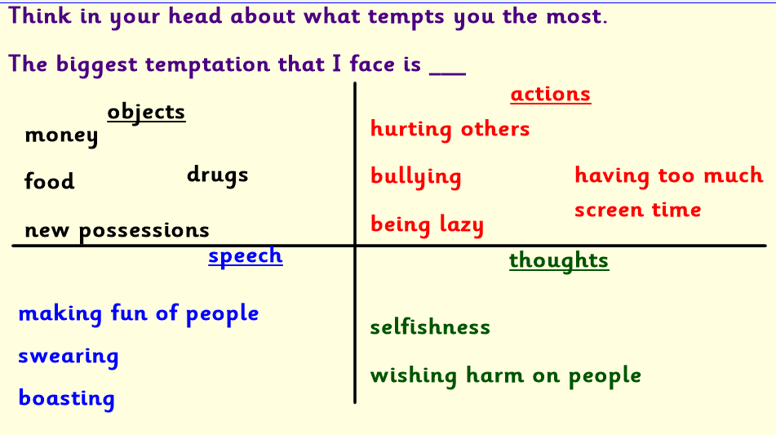

Slide 6
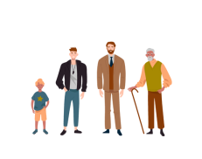
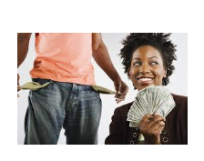
Different people can be tempted by different things.
Old and young people can be tempted differently.
Rich and poor people can be tempted differently.

Slide 7
What temptations do we face in life?
Adults
Both
Children

