Slide 1
Sketch Maps

Slide 2
Learning Objective
To understand how to draw a sketch map.
Success Criteria
To recognise the key features of a sketch map.
To understand how to draw sketch maps.
To draw two types of sketch maps - of a place and to show a route.

Slide 3

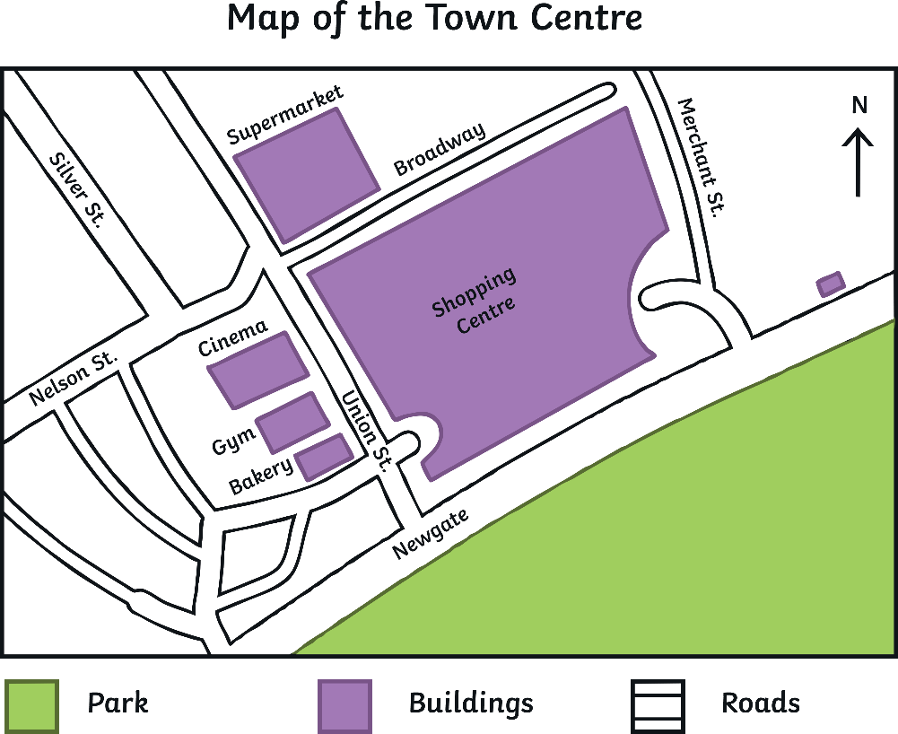

What Is a Sketch Map?
Think, Pair, Share
What is a sketch map?
How are sketch maps different to ‘real’ maps?
What are the pros and cons of using a sketch map to show what a place is like?
Map of the Town Centre
sketch map
A sketch map is a
very simple map
drawn from a ‘bird’s-eye view’.
It is not drawn to scale and
only shows the main features
of an area.
Key
Not to scale.

Slide 4

What Is a Sketch Map?
Look at this example of a sketch map. What key features should every sketch map have?
A sketch map should have:
a title;
a frame;
a key;
a north arrow;
simple line drawings with
very little detail;
labels and annotations (if needed).
You should also state that the
map is not drawn to scale!
Map of the Town Centre
Key
Not to scale.

Slide 5
What Is a Sketch Map?
Early explorers would have drawn sketch maps.
Their maps were not to
scale but were still very useful when new continents were being discovered!

Slide 6
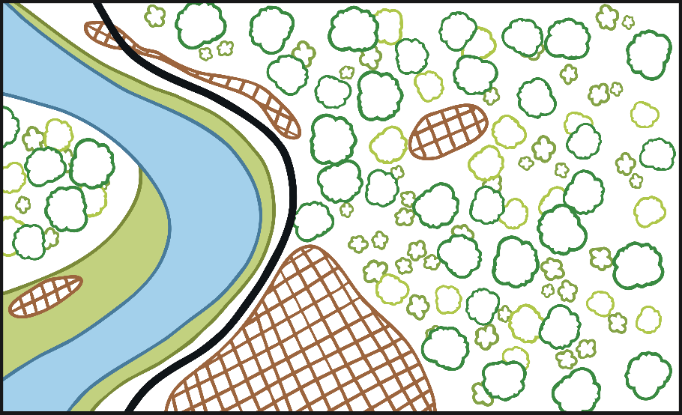
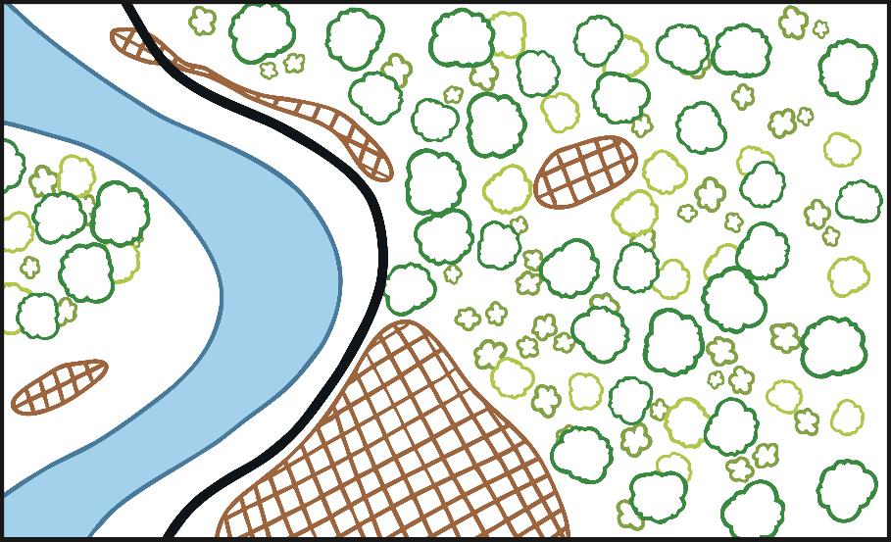
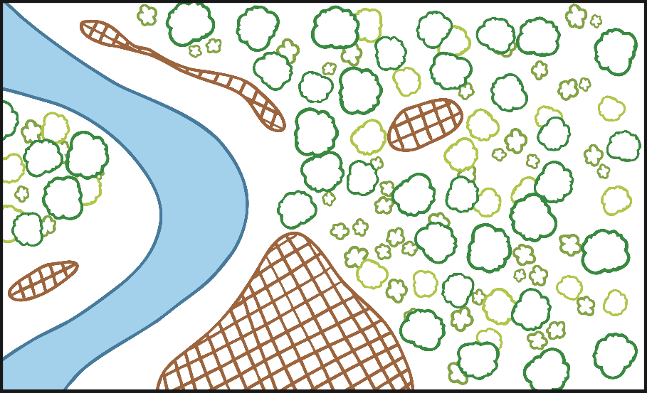
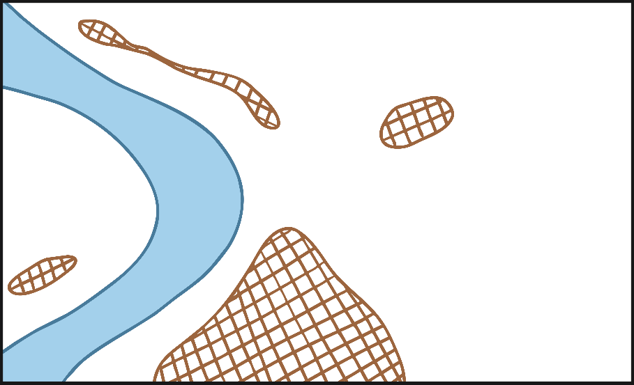

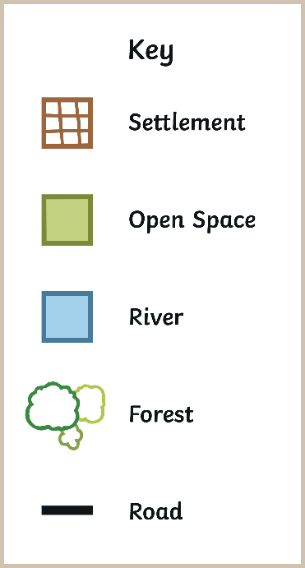


Drawing a Sketch Map of a Place
The River Elbe, Germany
The River Elbe, Germany
Click through this slide to see how a sketch map is made.
Key
Not to scale.

Slide 7
Drawing a Sketch Map of a Place
You are going to draw your own sketch map of the location shown in this photo.
Remember, a sketch map should have:
a title;
a frame;
a key;
a north arrow;
simple line drawings with
very little detail;
labels and annotations (if needed).
You should also state that the map is not drawn to scale!
Baska Voda Port, Croatia
Complete the Drawing a Sketch Map of a Place Activity Sheet.

Slide 8

Drawing a Sketch Map to Show a Route
Map of the Town Centre
You can also draw a sketch map to show a route.
This sketch map is not to
scale but it would still be useful to help someone find their way around the town
as it shows the main roads and landmarks.
Key
Not to scale.

Slide 9
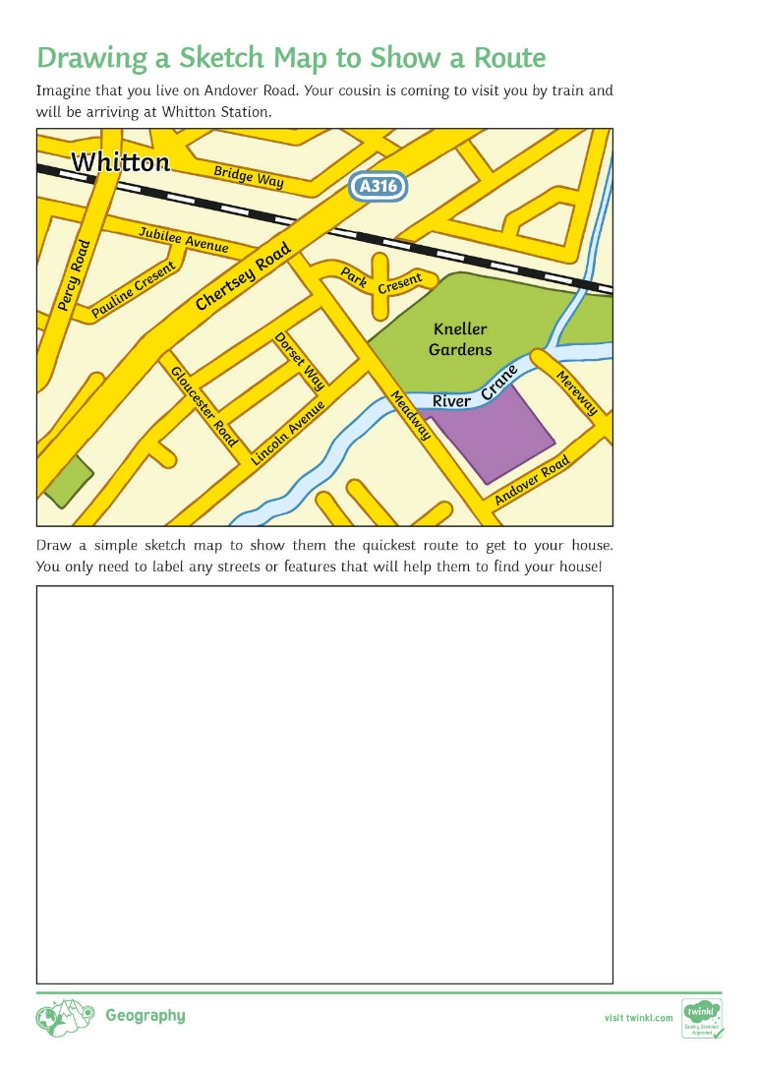
Drawing a Sketch Map to Show a Route
Complete the Drawing a Sketch Map to Show a Route Activity Sheet.
Remember, a sketch map
should have:
a title;
a frame;
a key;
a north arrow;
simple line drawings with very
little detail;
labels and annotations (if needed).
You should also state that the map is not drawn to scale!

Slide 10
3…2…1…
3
2
1
Three features that every sketch map should have.
Two examples
of when someone might use a
sketch map.
One extra fact that you have learnt about sketch maps.

