Slide 2



Diving into Mastery Guidance for Educators
Each activity sheet is split into three sections, diving, deeper and deepest, which are represented by the following icons:
These carefully designed activities take your children through a learning journey, initially ensuring they are fluent with the key concept being taught; then applying this to a range of reasoning and problem-solving activities.
These sheets might not necessarily be used in a linear way. Some children might begin at the ‘Deeper’ section and in fact, others may ‘dive straight in’ to the ‘Deepest’ section if they have already mastered the skill and are applying this to show their depth of understanding.
Diving
Deeper
Deepest

Slide 3
Aim
Use simple formulae.

Slide 4
Substitution
Diving
Substitute the values given for each shape to work out the values of each expression.
5
9
12
+
9
+
12
26
5
+
12
−
9
8
5
−
12
−7
5

Slide 5

Substitution
Diving
Use substitution to work out the values of these expressions.
Next, find the values of these expressions.
Top tip: think about what it
means when a number comes
directly before a letter.
a = 8 b = 1.5 c = 4
a + 16
a + c + b
a − b
ac
8 + 16
8 + 4 + 1.5
8 − 1.5
8 × 4
24
13.5
6.5
32
5a
4a – c
2b + a
ab + bc
5 × 8
4 × 8 − 4
2 × 1.5 + 8
8 × 1.5 + 1.5 × 4
40
28
11
18

Slide 6

Substitution
Deeper
Do you agree or disagree with each of these statements about this formula?
Try substituting numbers into the formula to test your thinking.
z = 2f – 5
1. In this formula, z always equals 1 and f always equals 3.
This statement is incorrect. When z = 1, f = 3, the formula is correct. However, we cannot state that z will always equal 1 and f will always equal 3. For example, if we substitute f = 4 and z = 3 into the formula, we find the formula still works:
2 × 4 – 5 = 3
2. In this formula, the value of z is 5 less than the value of f.
This statement is incorrect. The value of z is 5 less than the value of 2f (two lots of f ), not 5 less than the value of f on its own.

Slide 7

Substitution
Deepest
By using substitution, give each of the shapes a different value so that the value of the expression is a multiple of 3. Find four different possibilities.
= a square number
+
+
= a prime number
4 + 11 + 12 = 27
9 + 7 + 8 = 24
16 + 13 + 4 = 33
25 + 5 + 12 = 42
A variety of answers are possible, for example:
= a multiple of 4

Slide 8


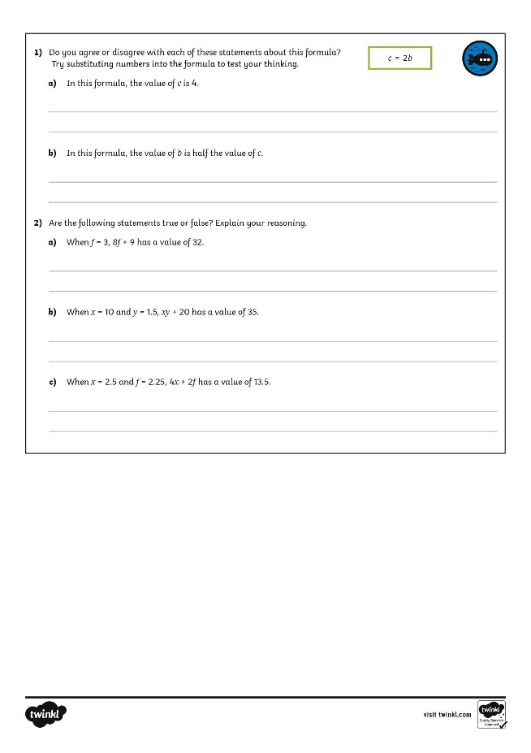
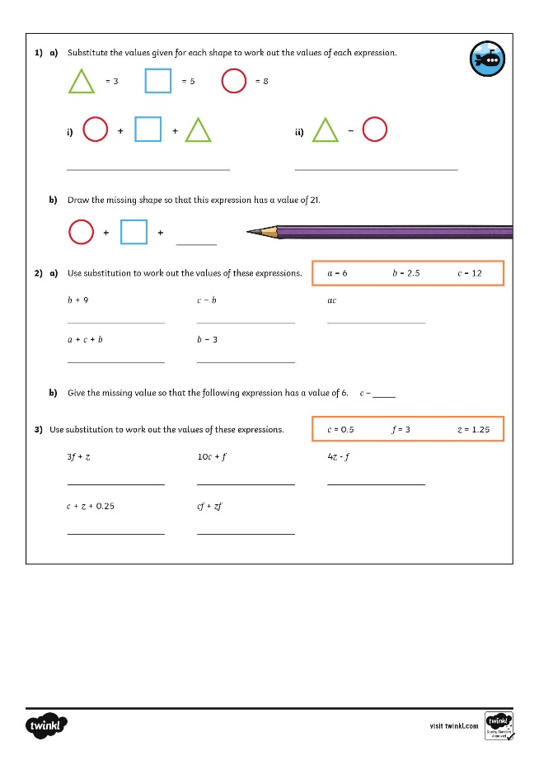
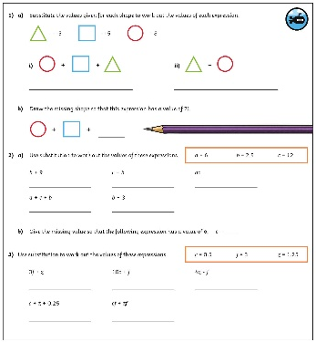
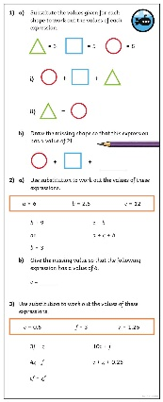
Substitution
Dive in by completing your own activity!

Slide 9
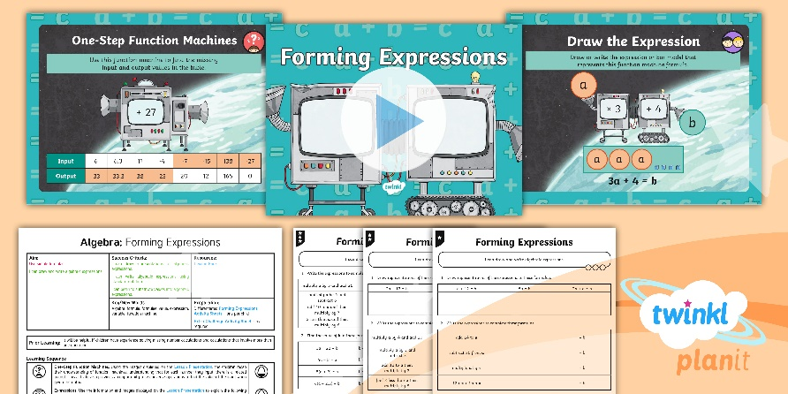
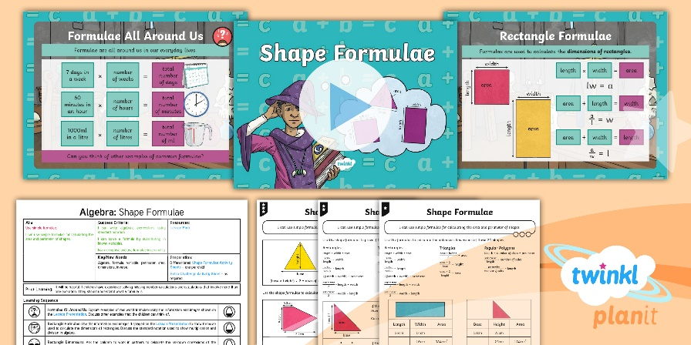

Need Planning to Complement this Resource?
National Curriculum Aim
Use simple formulae
For more planning resources to support this aim, click here.
Twinkl PlanIt is our award-winning scheme of work
with over 4000 resources.

