Slide 2



Diving into Mastery Guidance for Educators
Each activity sheet is split into three sections, diving, deeper and deepest, which are represented by the following icons:
These carefully designed activities take your children through a learning journey, initially ensuring they are fluent with the key concept being taught; then applying this to a range of reasoning and problem-solving activities.
These sheets might not necessarily be used in a linear way. Some children might begin at the ‘Deeper’ section and in fact, others may ‘dive straight in’ to the ‘Deepest’ section if they have already mastered the skill and are applying this to show their depth of understanding.
Diving
Deeper
Deepest

Slide 3
Aim
Use their knowledge of the order of operations to carry out calculations involving the four operations.

Slide 4



Order of Operations
Diving
Remember to use BODMAS/BIDMAS to help you remember the
order of operations.
Brackets | B |  | B | Brackets
Orders | O |  | I | Indices
Division | D |  | D | Division
Multiplication | M |  | M | Multiplication
Addition | A |  | A | Addition
Subtraction | S |  | S | Subtraction

Slide 5


Order of Operations
Diving
Add one pair of missing brackets to each of these calculations to make them correct:
Brackets | B |  | B | Brackets
Orders | O |  | I | Indices
Division | D |  | D | Division
Multiplication | M |  | M | Multiplication
Addition | A |  | A | Addition
Subtraction | S |  | S | Subtraction
7 × 6 + 14 = 56
(7 × 6) + 14 = 56
58 - 16 + 17 = 25
58 - (16 + 17) = 25

Slide 6
Order of Operations
Diving
Add two pairs of missing brackets to each of these calculations to make them correct:
Brackets | B |  | B | Brackets
Orders | O |  | I | Indices
Division | D |  | D | Division
Multiplication | M |  | M | Multiplication
Addition | A |  | A | Addition
Subtraction | S |  | S | Subtraction
6 × (9 – 3) = 6 + (5 × 6)
6 × 9 - 3 = 6 + 5 × 6
8 × 8 – 2 = 6 + 7 × 8
(8 × 8) – 2 = 6 + (7 × 8)

Slide 7



Order of Operations
Deeper
Look carefully at his calculation and describe the error that has been made with the order of operations.
24 + (18 ÷ 6) = 27
24 + 18 ÷ 6 = 7
Answer
The answer has been worked out by moving from left to right, ignoring BODMAS/BIDMAS. The correct answer is 27 as we would need to carry out the division first, followed by the addition.

Slide 8

Order of Operations
Deeper
There is a special offer at a local stationery shop. A notebook is normally £8 but if you buy more than 8 notebooks, you will get £3 off the price of each one. Harry decides to buy 9 notebooks. How much will the notebooks cost Harry at the special offer price?
Which calculation will allow Harry to work out how much his notebooks will cost?
(9 × 8) – 3 = £69
For every notebook that Harry buys priced at £8, a £3 discount is applied. He buys 9 notebooks, so there needs to be 9 lots of £8 - £3.
If the first calculation were used, he would find 9 lots of £8, which is the full price of the notebook, followed by taking away just one lot of £3. This would mean that Harry only has his £3 discount on one notebook rather than all 9 notebooks.
9 × (8 – 3) = £45
9 × (8 – 3) = £45

Slide 9

Order of Operations
Deepest
Set 1 | Set 2 | Set 3
2, 3, 4 | 5, 6, 7 | 8, 9, 10
Use a number from each of the sets above to complete the number
calculations below:
Number from Set 1
Number from Set 2
Number
from Set 3
Can you make an even number greater than 30?
( × ) + = 20
2
5
10
2
6
8
Possible answers might include:
(4 × 6) + 8 = 32
(4 × 7) + 10 = 38
(4 × 7) + 8 = 36
Number from Set 1
Number from Set 2
Number
from Set 3
( × ) + = 27
3
6
9
Number from Set 1
Number from Set 2
Number
from Set 3
( × ) + = 30
4
3
5
10
7
9

Slide 10


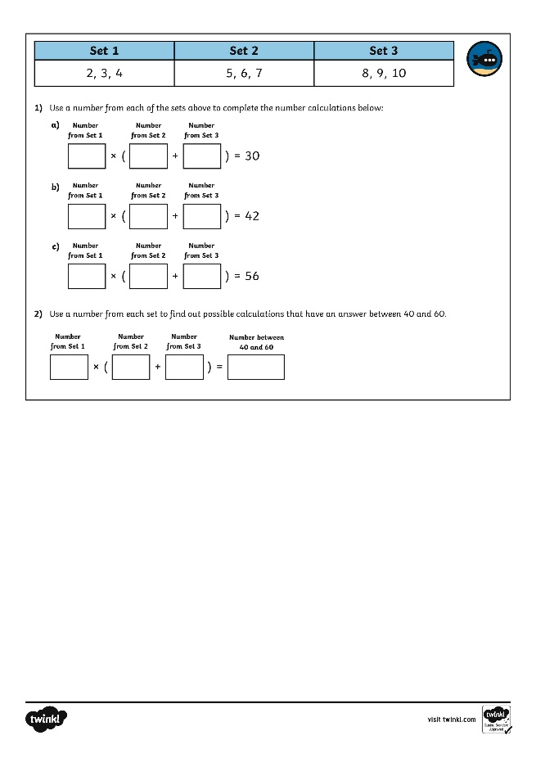
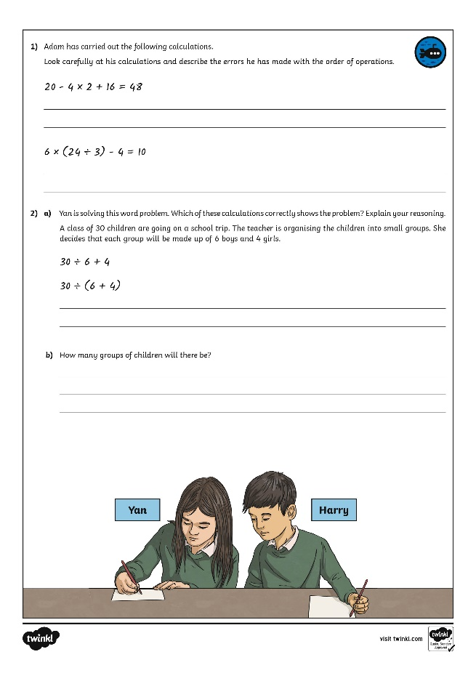
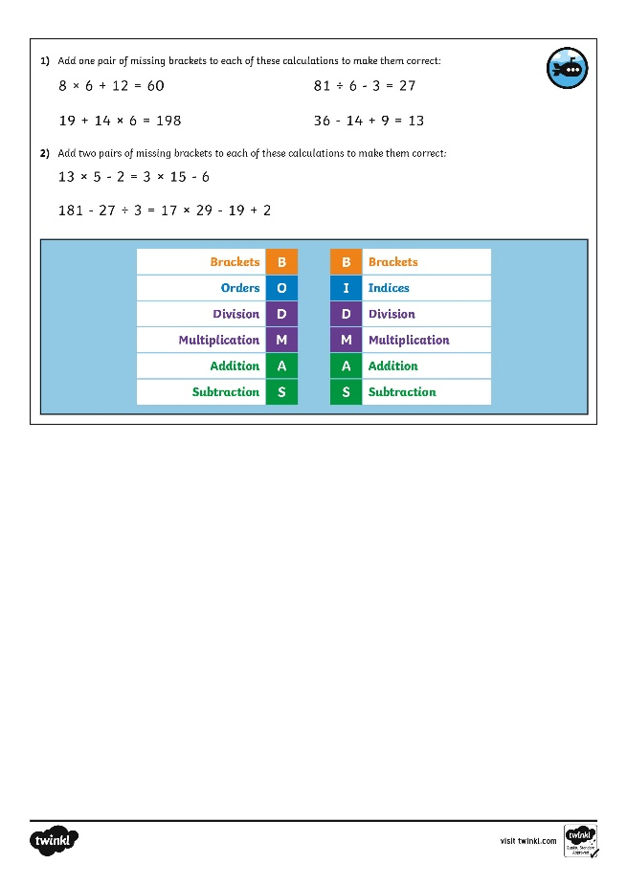

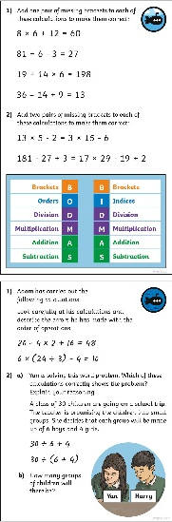
Order of Operations
Dive in by completing your own activity!

Slide 11
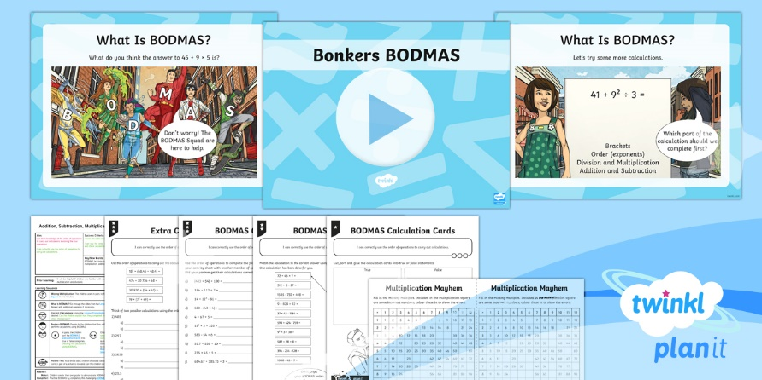
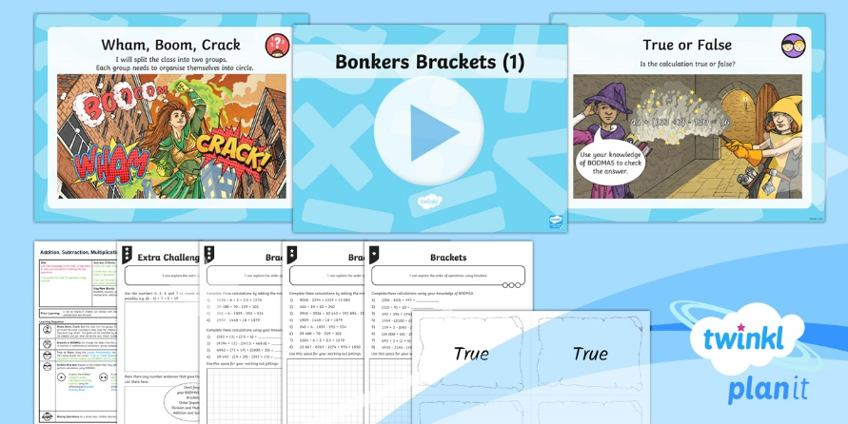

Need Planning to Complement this Resource?
National Curriculum Aim
Use their knowledge of the order of operations to carry out calculations involving the four operations.
For more planning resources to support this aim, click here.
Twinkl PlanIt is our award-winning scheme of work
with over 4000 resources.

