Slide 1
Date
LC: Can I understand what is spiritual?

Slide 2
This term we will be looking at how people show their spirituality through the arts. Write down what you know about this already. For example:
How do some religions use music?
What is spirituality?
What famous religious buildings do you know?
What do you know about religious art?

Slide 3
On the next slides, we will see examples of the arts in different religions. See if you can work out which religion each one is from.
?

Slide 4
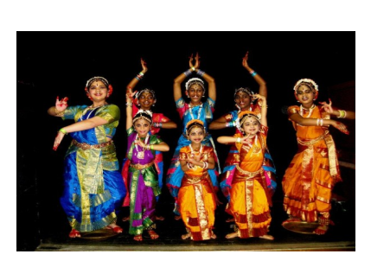
What religion is this from?
These Hindus are telling sacred stories through dance.

Slide 5
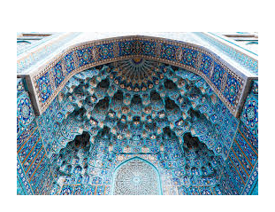
What religion is this from?
These tessellated walls are part of a mosque (Islam).

Slide 6
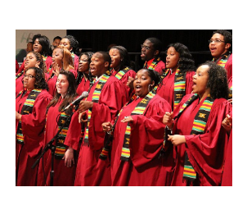
What religion is this from?
These Christians are singing in church.

Slide 7
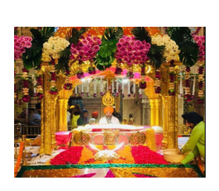
What religion is this from?
These Sikh are reading their holy book (Gurun Granth Sahib) in their Gurdwara.

Slide 8
What do we mean by spirituality?
By spirituality, we mean beliefs and feelings about religion, the soul and things that we cannot see.
Spiritual activities include prayer, reading a holy book, meditating and worshipping in a holy building.

Slide 9
Your task
Open the Document ‘Spiritual Pictures’
You will have a selection of different images. Some are religious pictures, some are pictures of nature and some are pictures of people. Discuss which pictures you find most spiritual. This might be because the pictures give them a religious feeling, or perhaps a feeling that there is more to the world than just the things that we can see.
Copy three pictures that you find most spiritual into a Google Doc and write a sentence for each one explaining your choice. Then send it to your teacher.

Slide 10
On the next slides are some of the pictures that you should have seen in the document.
Which of them do you find spiritual? That is, which either make you think about God or make you feel that you are part of a wider universe than just what you can see around you?

Slide 11
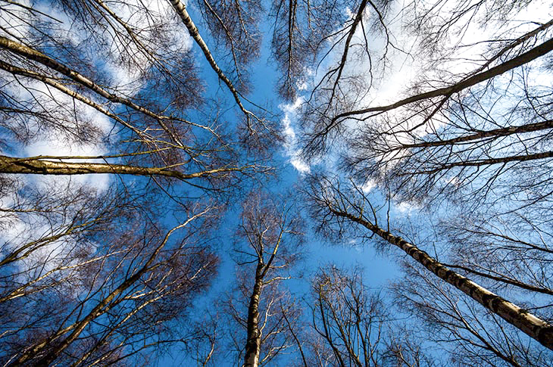
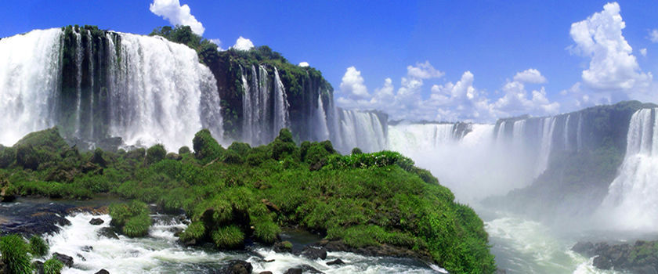
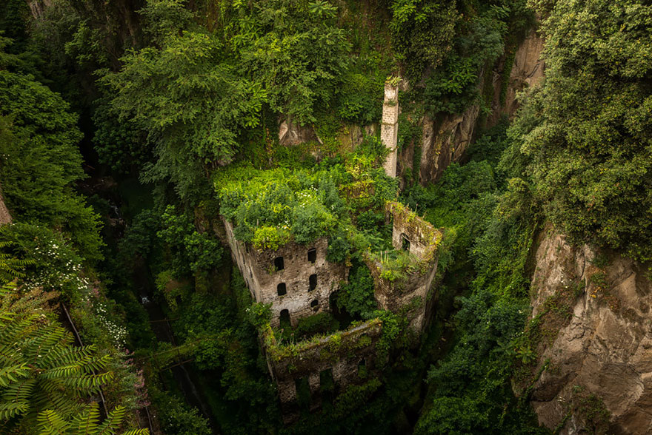

Images to choose from (1)

Slide 12
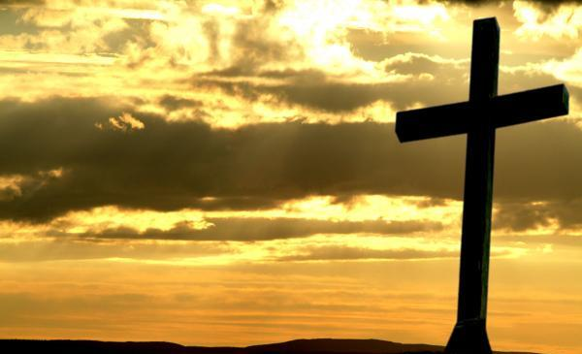
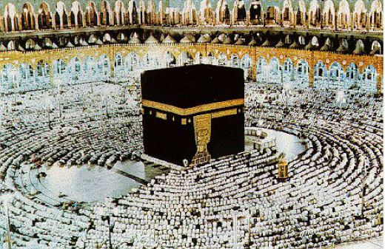
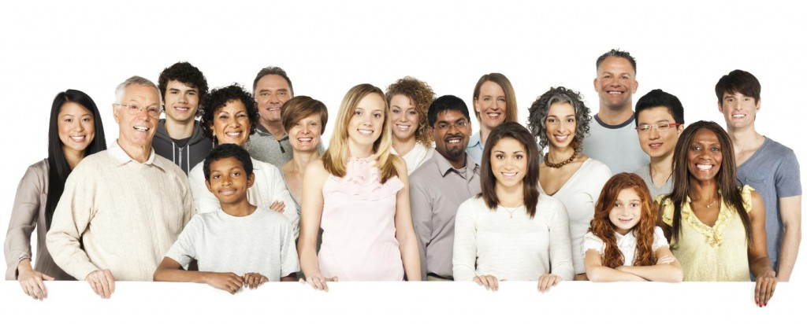
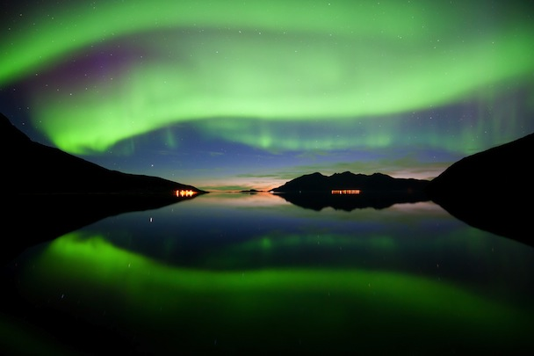
Images to choose from (2)

Slide 13
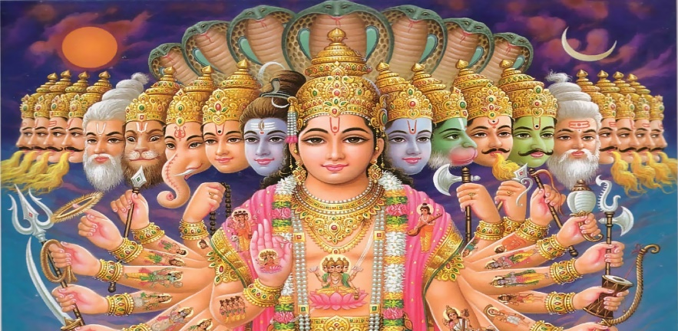
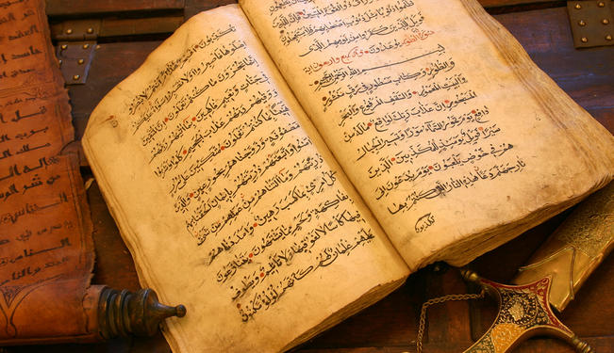
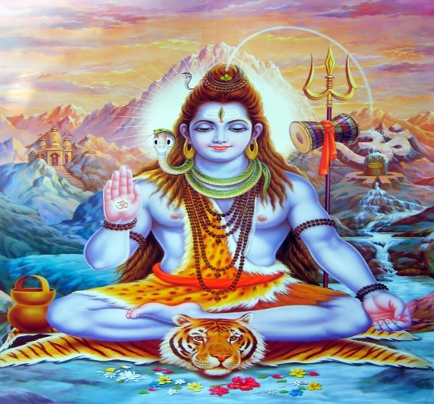
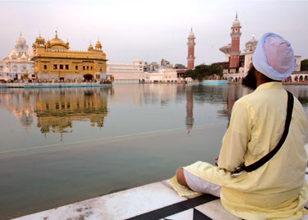
Images to choose from (3)

Slide 14
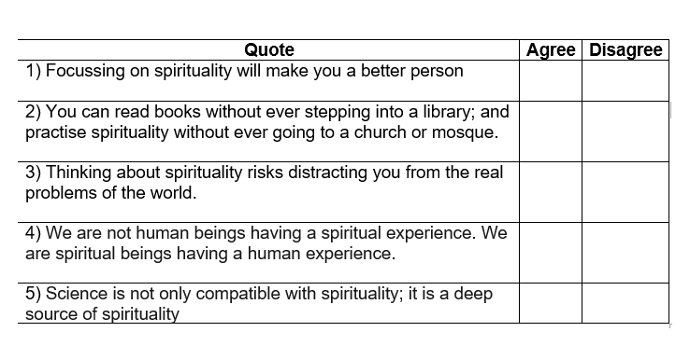
Final activity
Do you agree or disagree with these quotes?

