Slide 1
LC: Can I understand what is inspiring about Sikh architecture?

Slide 2
What do we mean by spirituality?
By spirituality, we mean beliefs and feelings about religion, the soul and things that we cannot see.

Slide 3
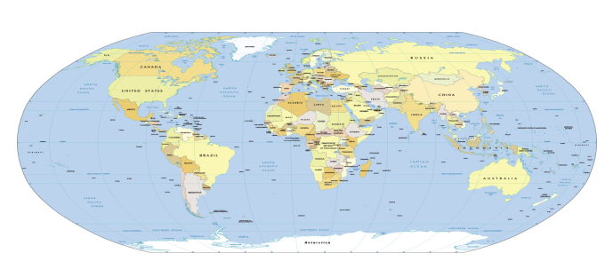
Today we are looking at the most spiritual place for Sikhs:
The Golden Temple. Do you know where it is?

Slide 4
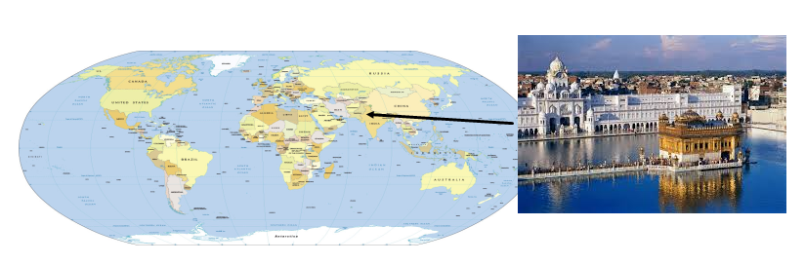
The Golden Temple is in Amritsar, which is the Indian state of Punjab.

Slide 5
This lesson we will be researching facts about The Golden Temple, explaining both what it looks like and why it is special.
https://www.northsouthtravel.com/10-interesting-facts-about-the-golden-temple
https://kids.kiddle.co/Golden_Temple
Where is it? When was it built? What is it used for? How many people visit it each year?
Why is it special for Sikhs? Why might non-Sikh people visit it?
Write these questions and their answers in your exercise books or in a Google Doc.

