Slide 1
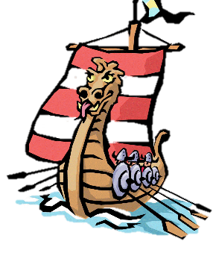
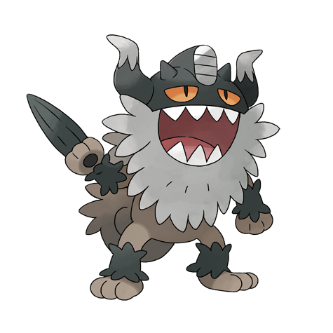
Key Questions
Introduction: What do I already know?
LC 1 | Who were the Anglo-Saxons and did they like the Vikings?
LC 2 | Which region of Britain would you have come under during the Heptarchy?
LC 3 | Why did the Vikings come to Britain and how did they make the journey?
LC 4 | What did the Brits learn from the Vikings?
LC 5 | What was life like for a 11 year old (boy/ girl) Viking?
LC 6 | How did the Vikings live when they came to Britain?
LC 7 | How can you create a Viking long boat from a range of materials?
Fantastic Finish: Children to prepare a Viking day when they show others the crafts and skills that the Vikings had.

Slide 2




Tuesday 16th March – 17th March
LC: Can I present what I have learned about this topic?
Self Assessment
What have you learned today? What have you succeeded in doing?
I can
I understand how to
I am able to
I know that
Over the past 8 weeks, you have learned about the Vikings – their life in both Scandinavia and Britain. You learned about the Vikings at home and at battle – You learned about their craftsmanship and culture through sagas.
Our question focussed on the pre-conceived notion that Viking were vicious – was this the case? Would you also consider the Vikings as victorious?
Today you will be working on an extended project to display your learning. This will be completed over 4 sessions so consider what you want to do, plan it out and give yourself time to produce a piece that reflects your understanding

Slide 3
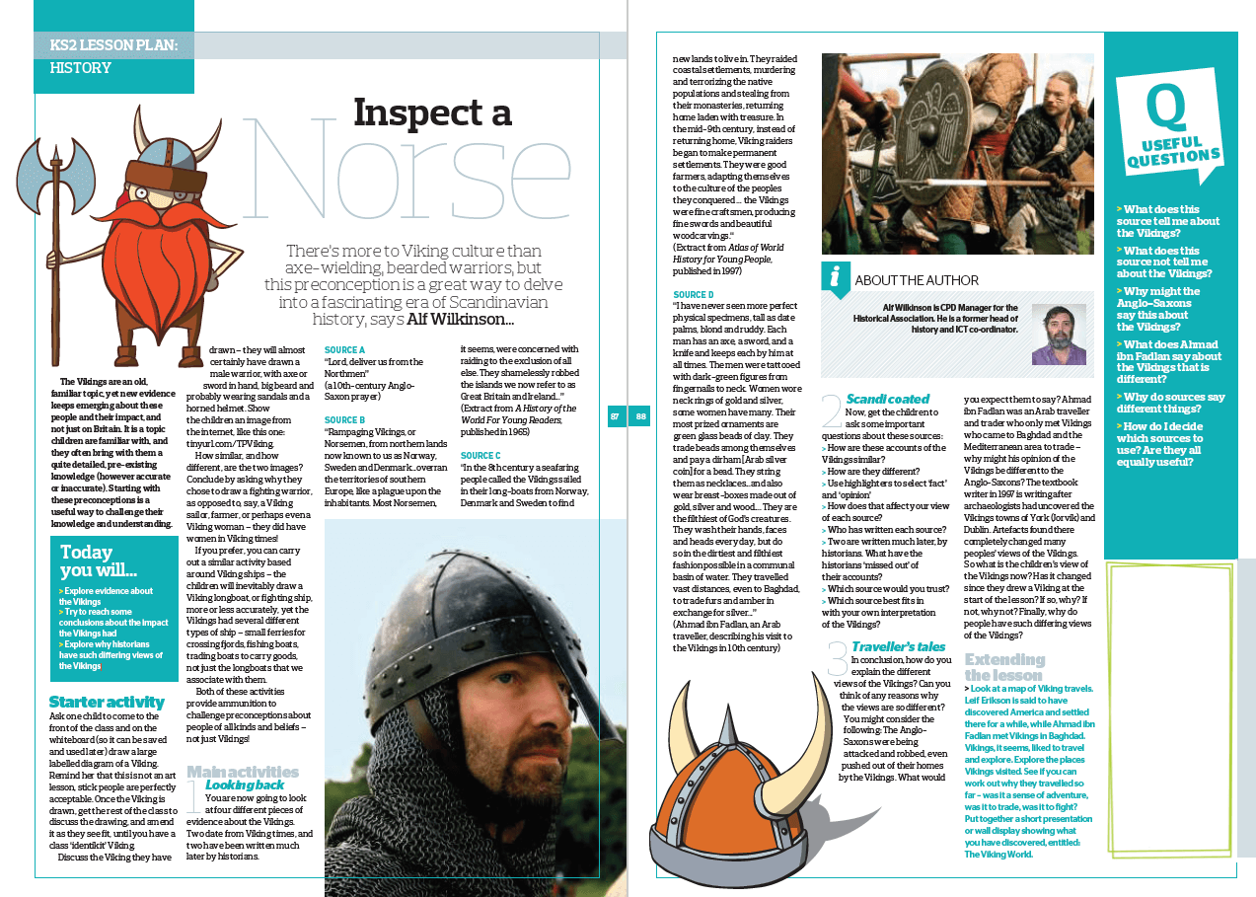
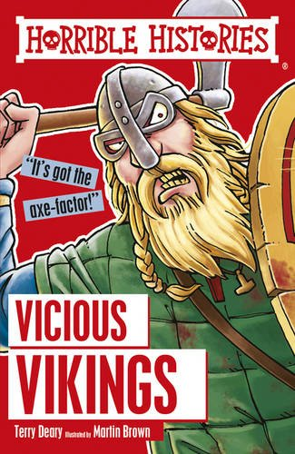
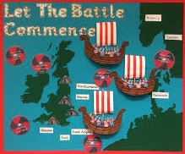
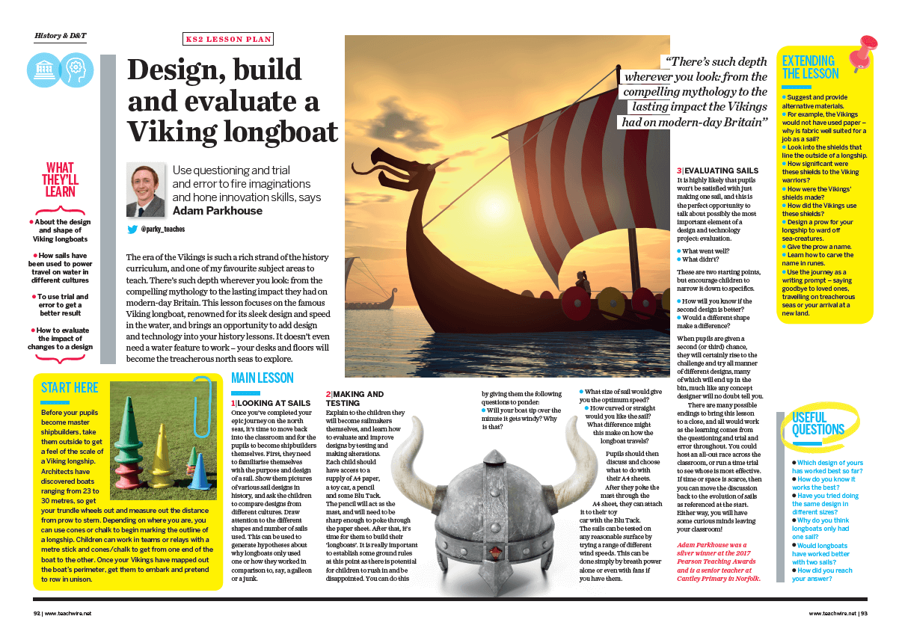
Are you a budding historian? Create a resource book that could be used by other children to learn about the Vikings. This can include a contents of your topics. Use real reference books to support your ideas and presentation.
Create a project poster which includes clear different sections. You could include a Viking craft area alongside key questions and answers; sections on historical information and artefacts
Choose your favourite area of the Vikings topic to create a piece of art supported by historical information. You could create a map showing where the Vikings invaded, then include key details about famous attacks

Slide 4
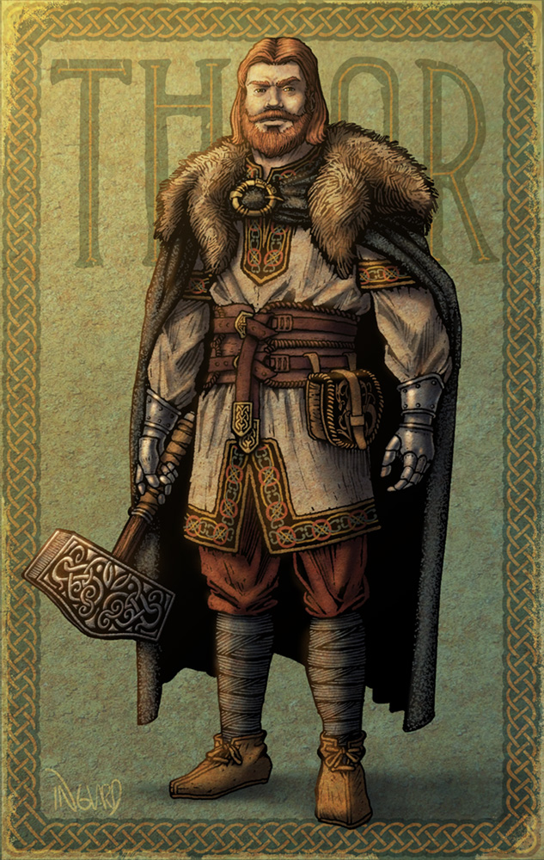
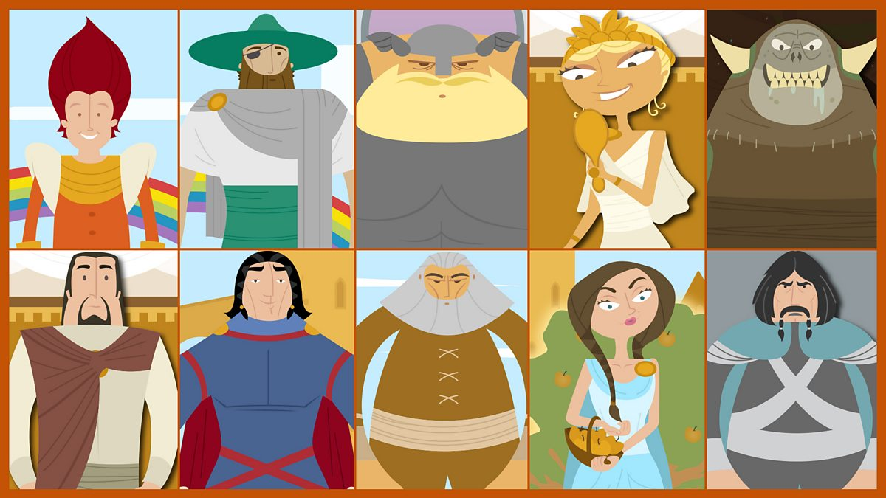
Were you inspired by the sagas and want to write your own? This could include details that you have learned about the Vikings and their beliefs
Has Marvel inspired you to learn more about Viking Gods? – Create a character profile detailing the Viking beliefs and tales of your chosen God. How did Vikings worship this god? Consider how they affected the lives of the Vikings,
You could even create a graphic novel detailing your saga. Or, could you create a your own story detailing the life of a Viking child, inspired by what you’ve learned about their lives?

