Slide 1




BEST Midlands
Education Associates
Primary Languages
Understanding others Understanding more about yourself
Français

Slide 2
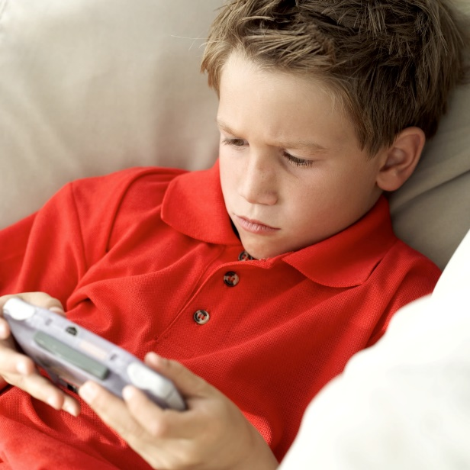
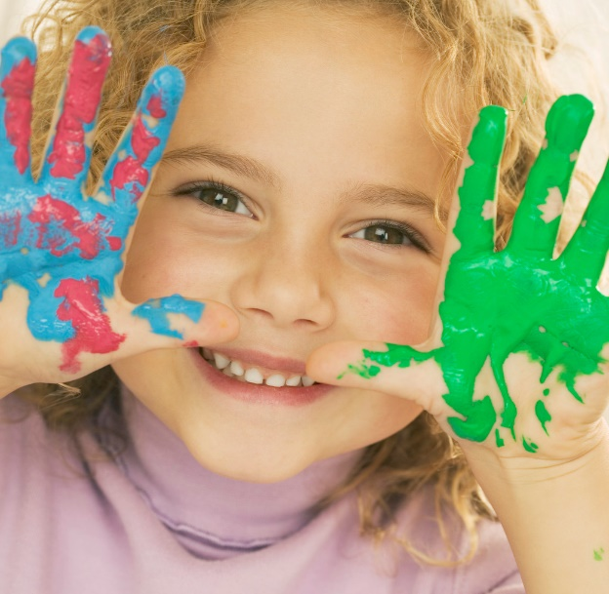
Je suis…….
What are we learning today?
You will learn how to talk about yourself

Slide 3



Je suis…………….

Slide 4
Je suis

Slide 5
What’s missing?

Slide 6
What’s missing?

Slide 7

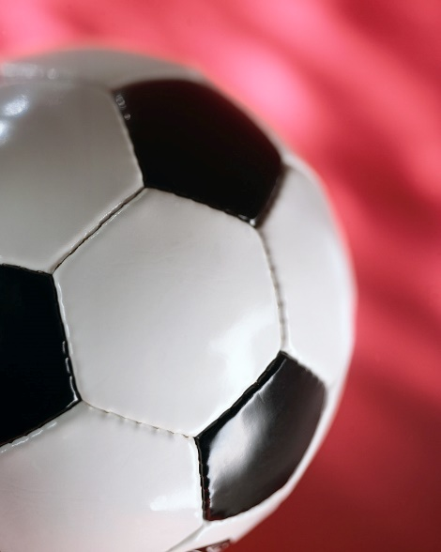
Je suis…………….

Slide 8
Je suis…………….

Slide 9
What’s missing?

Slide 10
What’s missing?

Slide 11

Work with a partner partner 1 – think of a description partner 2 – guess what it is!

Slide 12
Match up
Je suis cool
Je suis de Bloxwich
Je suis né à Walsall
Je suis intelligente

Slide 13

Match up
Je suis sportif
Je suis fana de musique
Je suis britannique
Je suis fana de foot

Slide 14
Complete the phrase
Je suis….

Slide 15

Super
What does je suis mean?
Answer: I am. Je is the French for I
What other phrases do you know which use je ?
Answer: je m’appelle ( I am called..) This is called the ‘first’ person.

Slide 16
Super
Some phrases sound different for boys and girls? Which ones?
Answer: intelligent/ intelligente. For the girls version it changes the sound the ‘t’ is sounded and the letter e is added.
Look out for some more.

