Slide 1


Sikh and Hindu inspirational leaders
Complete your topic tree of what you already know about Sikh and Hindu inspirational leaders and also what you would like to learn about.
In this unit we will be focusing on key leaders in both religions.

Slide 2
Monday 17th September.
LC: Can I describe what I know about Sikhs and Hindus?
G: I can explain the differences between Sikhs and Hindus.
B: I can discuss differences between religions.
R: I can identify the differences between Hindus and Sikhs.

Slide 3
What do Sikhs believe?
What do Hindus believe?
Are these beliefs different?
People who follow the Sikh/Hindu religion believe …
Both religions share/differ in ….

Slide 4
LC: Can I describe what I know about Sikhs and Hindus?
Task
Using the information from: http://www.primaryhomeworkhelp.co.uk/religion/hinduism.htm
http://www.primaryhomeworkhelp.co.uk/religion/sikhism.html
you are going to create a mind map in mixed ability pairs.
You will either be looking at Sikhism or Hinduism.

Slide 5
Monday 17th September.
LC: Can I describe what I know about Sikhs and Hindus?
G: I can explain the differences between Sikhs and Hindus.
B: I can discuss differences between religions.
R: I can identify the differences between Hindus and Sikhs.

Slide 6
Plenary
Feed back and discuss what you have found out as a group.

Slide 7
Monday 24th September.
LC: Can I identify what makes an inspirational leader?
G: I can describe qualities required to be an inspirational leader.
B: I can explain characteristics needed to be inspirational leader.
R: I can identify what is needed to be a good leader.

Slide 8
Over the next few weeks we are going to be looking at what makes a good leader and a key inspirational leader in the Sikh religion.

Slide 9
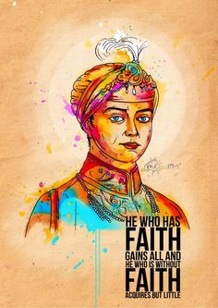
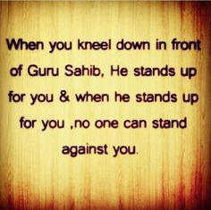
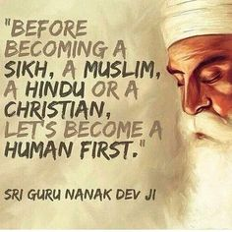
Quotes from inspirational Sikh leaders.

Slide 10


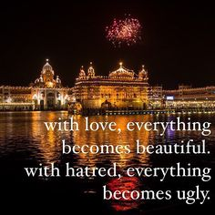

Slide 11
What is a hero?
Who is your inspiration?
Write an answer for each question
What makes them inspirational or a hero?
How do they make you feel?

Slide 12
LC: Can I identify what makes an inspirational leader?
Task
I’m going to give you a list of qualities.
Choose 3 qualities which you think are important to becoming an inspirational leader.
Discuss on in groups of 4.
Do you feel there are any qualities missing from the list?
What makes a good leader?

Slide 13
In your books.
Write the qualities your group have decided upon for a good leader.
The qualities to make a good leader are …
Who in the class might lead? Who has leadership qualities and could be head teacher, prime minster, peace maker, army general etc..
Record answer in your book.
When is it hard to lead? Is it easy to follow?

Slide 14
Monday 24th September.
LC: Can I identify what makes an inspirational leader?
G: I can describe qualities required to be an inspirational leader.
B: I can explain characteristics needed to be inspirational leader.
R: I can identify what is needed to be a good leader.

Slide 15
Plenary
What qualities does a person need to be an inspirational leader?

Slide 16
Monday 1st October.
LC: Can I understand what the stories of Guru Nanak teach us?
G: I can describe the importance of Guru Nanak for Sikhs.
B: I can discuss what makes Guru Nanak a key leader for Sikhs.
R: I can state what makes Guru Nanak a good leader..

Slide 17
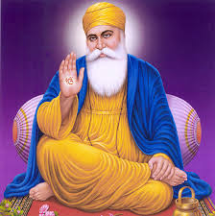
Power point ..\..\2017-18\Year 6\resources\The_Life_of_Guru_Nanak[1].ppt
Who can remember what qualities with came up with in our last lesson that make a good leader?
What makes the Guru someone to admire in these stories?

Slide 18
What happened to Guru Nanak that caused him to start teaching people about God?
What sort of person was Guru Nanak?
What made him different from the others?
I think that …..
I think Guru Nanak was different because …

Slide 19
LC: Can I understand what the stories of Guru Nanak teach us?
Task
G: You are a reporter reporting on Guru Nanak, how did he inspire others by his actions.
B: Read the stories and choose one to write about. Why does this story make Guru Nanak a key/ good leader?
R: Glue an image of Guru Nanak into your book. Then write the qualities that he has shown in the stories. his like.

Slide 20
Wednesday 1st October.
LC: Can I understand what the stories of Guru Nanak teach us?
G: I can describe the importance of Guru Nanak for Sikhs.
B: I can discuss what makes Guru Nanak a key leader for Sikhs.
R: I can state what makes Guru Nanak a good leader.

Slide 21
Plenary.
Share some of the work.

Slide 22
Monday 8th October.
LC: Can I understand why Mahatma Gandhi was an inspirational leader to the Hindus?
G: I can describe the impact of Gandhi’s principles and show how powerful his words are today.
B: I can make links between Gandhi’s beliefs and the way he chose to live his life.
R: I can identify some of the values that Gandhi showed in his life.

Slide 23
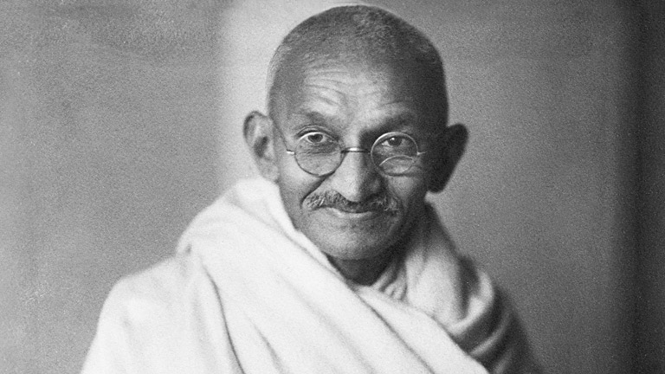
What do you understand by the term disagreements and arguments?
Groups of 3 or 4 discuss the following questions and record your answers on whiteboards.
Who do you argue with?
When do you think you are treated unfairly?
How do you resolve your disputes?
I argue with ..
I think I am unfairly treated when …
I would try to ...

Slide 24

Feedback what you have.
Has anyone used violence to get their own way?
What is Ahimsa?
is a term meaning 'not to injure' and 'compassion'. The word is derived from the Sanskrit root hiṃs – to strike; hiṃsā is injury or harm, a-hiṃsā is the opposite of this, i.e. cause no injury, do no harm.

Slide 25
Gandhi
One of the most famous leaders of a non-violent movement was Mohandas K. Gandhi (1869-1948), who opposed British imperial rule in India during the 20th century.
Gandhi took the religious principle of ahimsa (doing no harm) common to Buddhism, Hinduism and Jainism and turned it into a non-violent tool for mass action. He used it to fight not only colonial rule but social evils such as racial discrimination and untouchability as well.
Gandhi called it "satyagraha" which means 'truth force.' In this doctrine the aim of any non-violent conflict was to convert the opponent; to win over his mind and his heart and persuade him to your point of view.
Gandhi was firm that satyagraha was not a weapon of the weak - "Satyagraha is a weapon of the strong; it admits of no violence under any circumstance whatever; and it always insists upon truth."
Gandhi did not think that non-violence was a tool for those who were too scared to take up arms (an accusation that was sometimes made).

Slide 26
MAHATMA GANDHI ppt.ppt
https://www.youtube.com/watch?v=WW3uk95VGes

Slide 27
My non-violence does not admit of running away from danger and leaving dear ones unprotected. Between violence and cowardly flight, I can only prefer violence to cowardice. I can no more preach non-violence to a coward than I can tempt a blind man to enjoy healthy scenes.
Gandhi, Young India, 28 May 1924
Non-violence is a power which can be wielded equally by all - children, young men and women or grown-up people, provided they have a living faith in the God of Love and have therefore equal love for all mankind. When non-violence is accepted as the law of life, it must pervade the whole being and not be applied to isolated acts.
Gandhi, Harijan, 5 September 1936
Non-violence is an active force of the highest order. It is soul force or the power of Godhead within us.
Gandhi, Harijan, 12 November.935

Slide 28
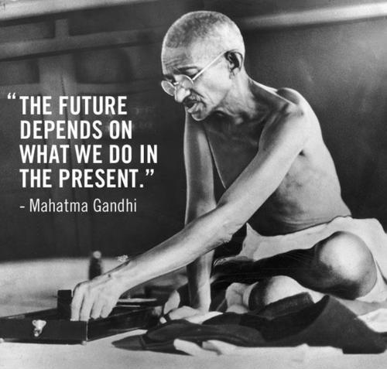
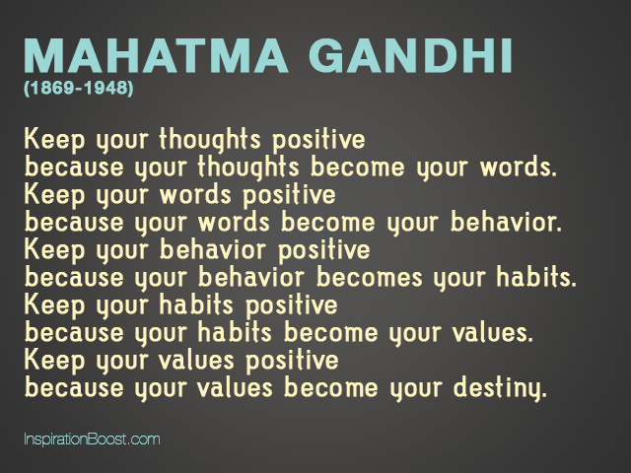

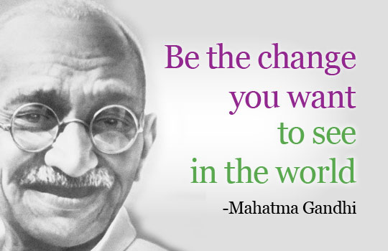
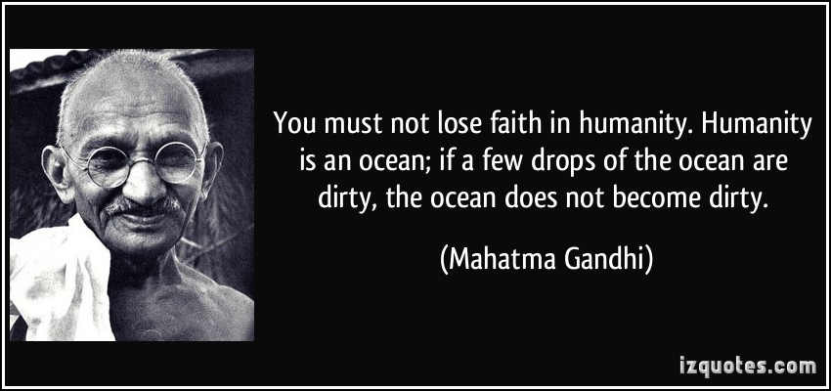
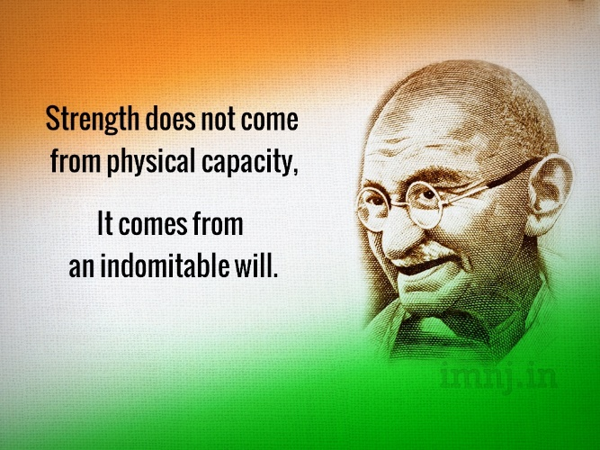
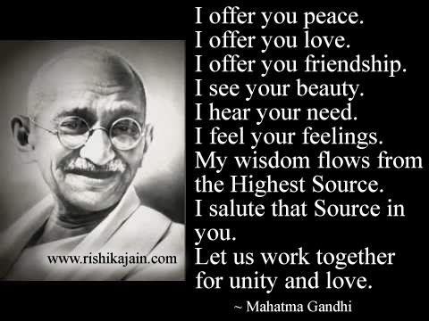
Quotes from Gandhi.

Slide 29
LC: Can I understand why Mahatma Gandhi was an inspirational leader to the Hindus?
All groups to explain the meaning of Ahimsa.
G: Think about a situations, you think is unfair, either at school or in the world. How would applying the quotes or principles of Gandhi’s help?
B: Glue into your book a scenario of a situation. How do you think Gandhi would have handled the situation?
Which one of Gandhi’s quotes would you use and why?
R: Think of a situation that is unfair. Divide your page into 3 parts. At the top draw a picture of the situation use speech bubbles to help describe what is happening. In the middle: write a quote from Gandhi that would help the situation. At the bottom draw or write how the situation has improved.

Slide 30
Monday 8th October
LC: Can I understand why Mahatma Gandhi was inspirational leader to the Hindus?
G: I can describe the impact of Gandhi’s principles and show how powerful his words are today.
B: I can make links between Gandhi’s beliefs and the way he chose to live his life.
R: I can identify some of the values that Gandhi showed in his life.h
life.

Slide 31
Monday 15th October
LC: Can I understand how religious beliefs make a difference to the lives of individuals and communities?
G: I can explain what makes each of these leaders inspirational to their followers.
B: I can make links between each leader and their religion.
R: I can identify what makes each leader inspirational. life.

Slide 32

Review – What have we learnt in this unit? TTYP.
Feedback.
Who is your favourite inspirational leader and why?
Mahatma Ghandi or Guru Nanak. TTYP
Feedback
Do different religions have the same values?
Do we need role models? Why or why not?
What can we learn from these inspirational leaders?

Slide 33
LC: Can I understand how religious beliefs make a difference to the lives of individuals and communities?
G: Find links between the Sikh and Hindu religious teachings and explain how the leaders used this to inspire their followers. Write a paragraph. Look back at what you have learnt.
B: Answer the following question.
What can we learn from the actions, achievements and qualities of these leaders?
To explain what made each inspirational leader and how this affected their followers.
R: Write a paragraph explaining which leader you think is the most inspirational and why.
Guru Nanak and Mahatma Gandhi.

Slide 34
Monday 15th October
LC: Can I understand how religious beliefs make a difference to the lives of individuals and communities?
G: I can make links between each leader and their religion.
B: I can explain what makes each of these leaders inspirational to their followers.
R: I can identify what makes each leader inspirational. life.

Slide 35
Complete topic tree.
What have you learnt.

