Slide 1
It’s not Rubbish!
Assembly on waste
Notes:
Today’s assembly is all about energy.
Use this template if you’re presenting to primary age children. There is a separate presentation for 11+ at http://jointhepod.org/resources/resource/80

Slide 2
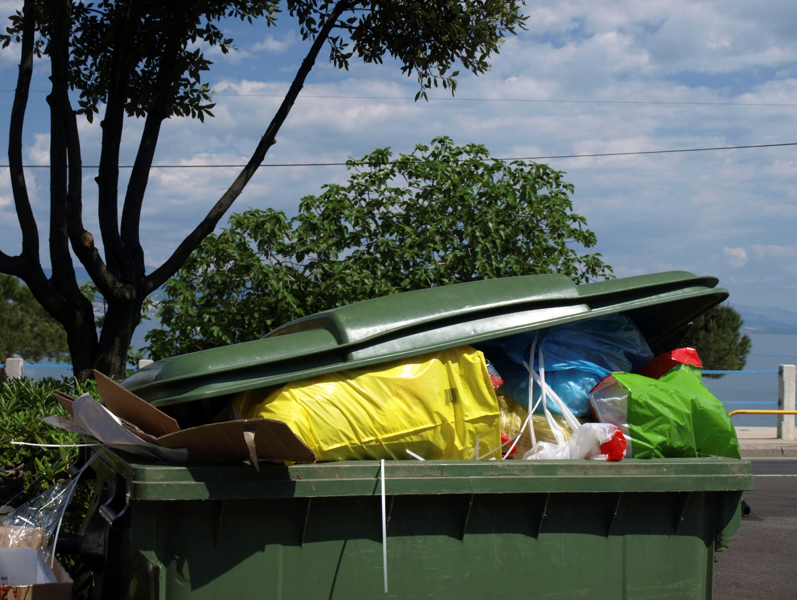
What is waste?
Many of the everyday things we do creates waste.
Write a list of things that create waste everyday?
Not just what is put in the bins but on the streets as well.
Notes:
What is waste?
Waste is something that someone doesn’t need or want anymore.
Many of the things we do every day create waste.
Ask the children to suggest things that people do everyday that create waste. Write their answers on a board.
Remind them that it's not just what we put in our bins or the litter you see on the streets.

Slide 3
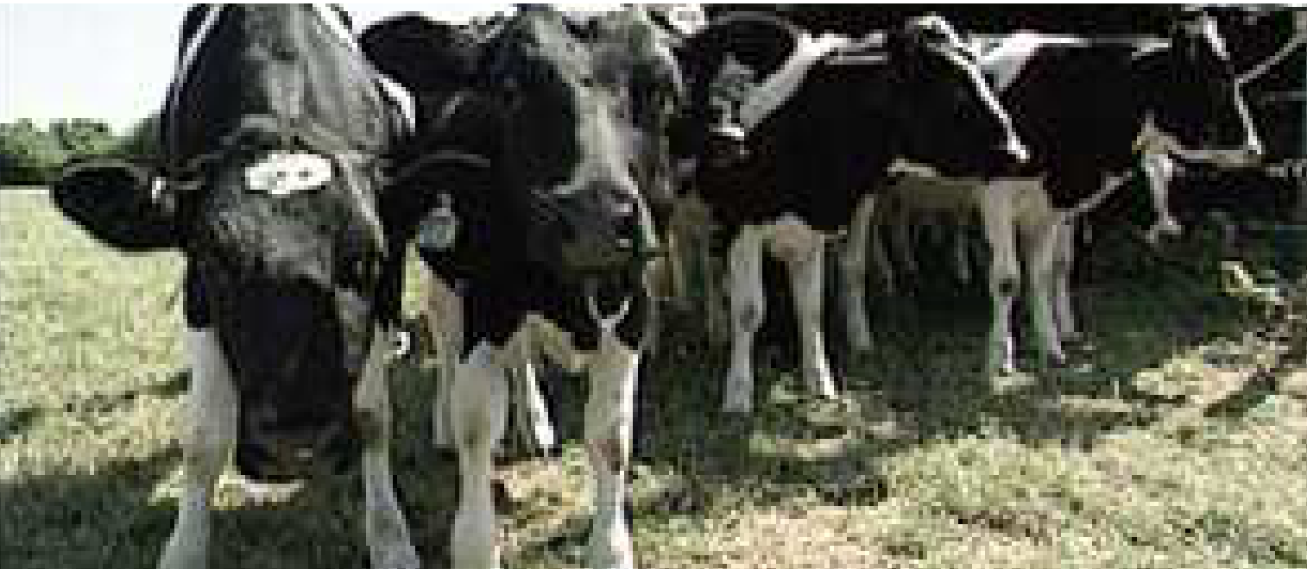
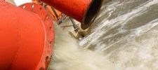
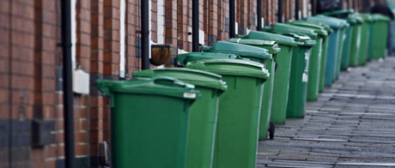
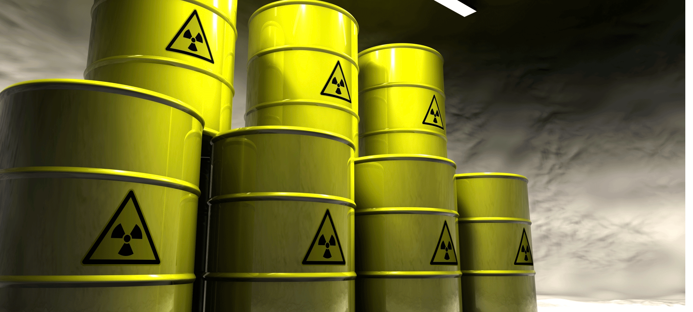
What’s the biggest source
of waste in the UK?
Agricultural, Industrial, Household or Hazardous?
Notes:
What's the biggest source of waste in the UK?
Ask the children to vote for the one they think is the biggest source of waste in the UK. When they have voted, see if they are surprised by the answer – agricultural waste.
Agricultural waste is the largest single source of waste. Both crop farming (growing things like cereals, fruit and vegetables) and animal farming produce waste.
In the past, farms used to be small, and farmers would grow food crops and raise animals. They used manure from the animals as fertiliser for the crops, and fed unwanted parts of the plant crops to the animals.
Today farms are usually larger. In order to make a profit, they often concentrate on just one type of crop or animal. This creates more waste.
Photos: Agricultural (BBC), Industrial (Getty), Household (Guardian), Hazardous (Surrey CC)

Slide 4
Agricultural waste is the largest single source of waste. Both crop farming (growing things like cereals, fruit and vegetables) and animal farming produce waste.
In the past, farms used to be small, and farmers would grow food crops and raise animals. They used manure from the animals as fertiliser for the crops, and fed unwanted parts of the plant crops to the animals.
Today farms are usually larger. In order to make a profit, they often concentrate on just one type of crop or animal. This creates more waste.

Slide 5
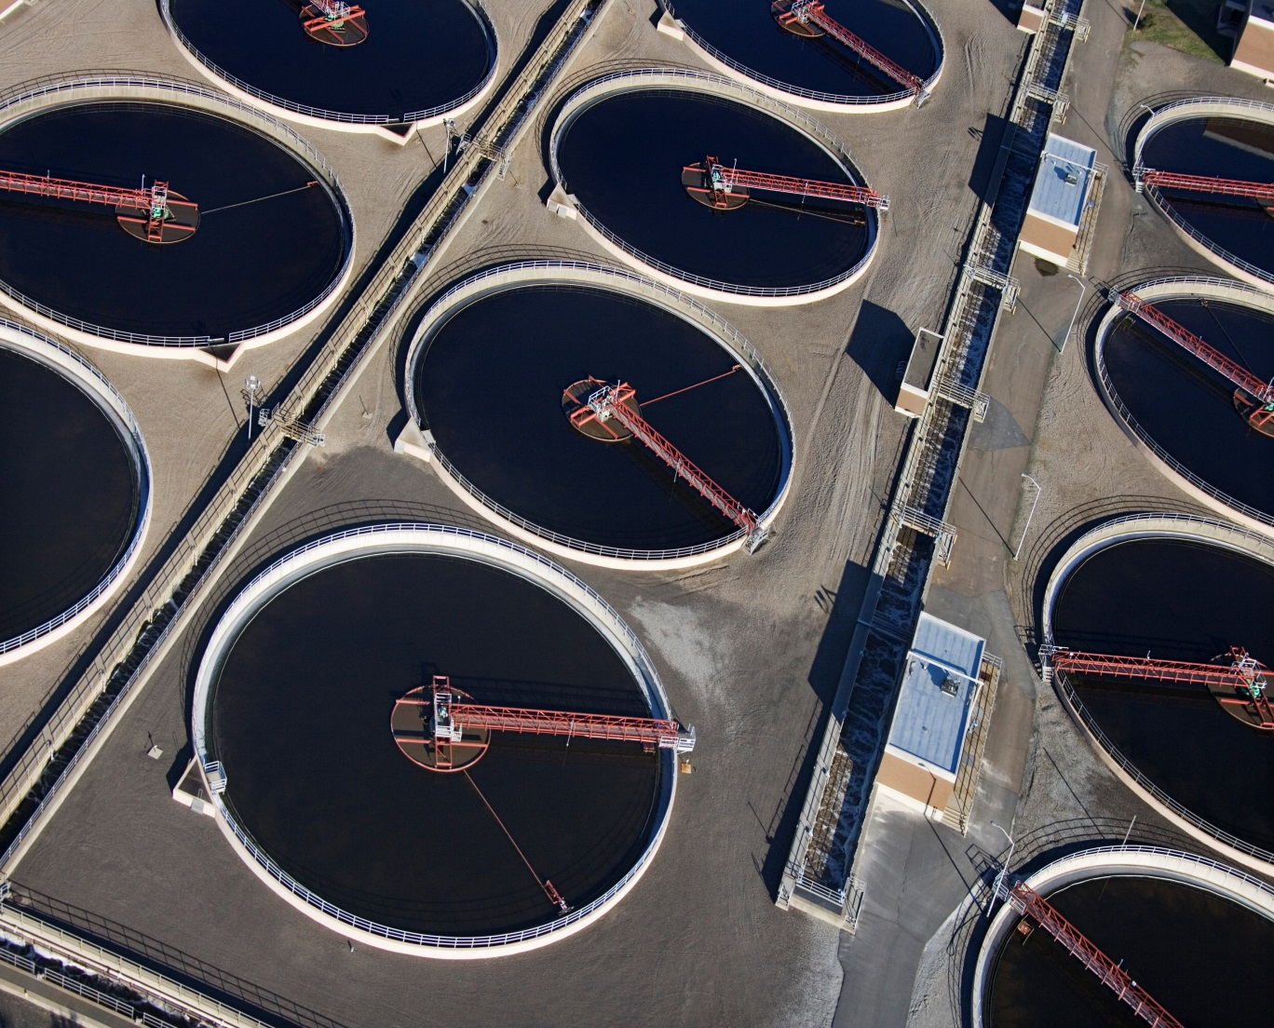
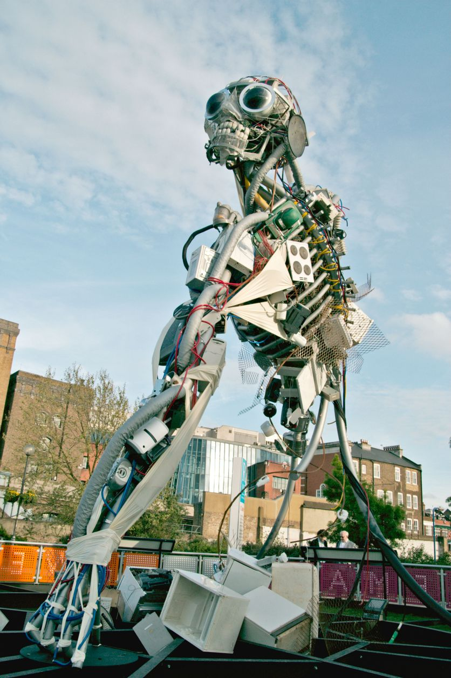
Industrial waste
This is solid or liquid waste which is left over after various industrial processes.
Notes:
Industrial waste: This is solid or liquid waste which is left over after various industrial processes.
What do we mean by industrial processes?
You don't have to look far to see things that have been made by industrial processes:
fabrics like polyester fleece that keeps you warm (polyester is made from chemicals);
computers here, at home and in the workplace (lots of metals and plastic);
the snack bar, crisps or cheesy dip in your lunchbox (the food ingredients and the plastic or paper wrapping)

Slide 6
What do we mean by industrial processes?
You don't have to look far to see things that have been made by industrial processes:
fabrics like polyester fleece that keeps you warm (polyester is made from chemicals);
computers here, at home and in the workplace (lots of metals and plastic);
the snack bar, crisps or cheesy dip in your lunchbox (the food ingredients and the plastic or paper wrapping)

Slide 7
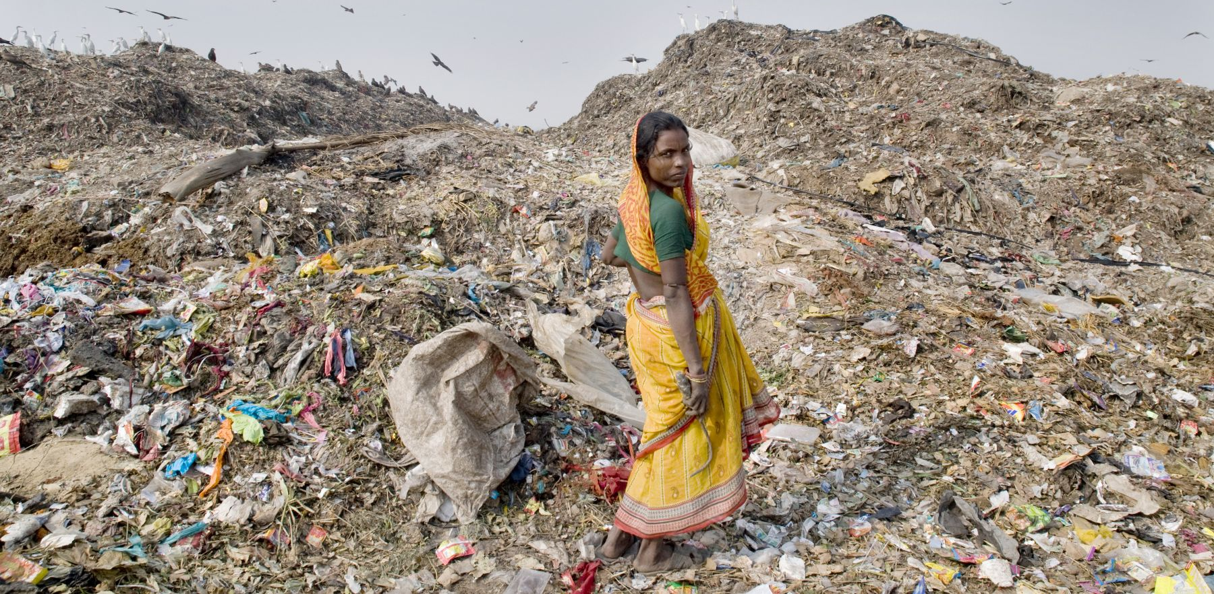
Is waste a problem?
What do you think?
Notes:
Ask the children this question:
Is waste a problem?
Most of them will probably agree that it is!
Some things to think about
Some UK councils send landfill by sea to other countries
In countries such as India and China, some children and young people have to sort through rubbish in landfill sites to find rags or other things they can sell for recycling. They are trying to earn enough to live on.
Photo: Brijesh Patel GD*7531770 (A*1582853)

Slide 8
Is waste a problem?
Most of you will probably agree that it is!
Some things to think about
  Some UK councils send landfill by sea to other countries
  In countries such as India and China, some children and young people have to sort through rubbish in landfill sites to find rags or other things they can sell for recycling. They are trying to earn enough to live on.

Slide 9
What is waste?
Some facts about household waste might surprise you.
What fraction of the food they buy does a typical UK household put in the bin in one year?
1/10
1/5
1/4
1/3
1/2
All of it!
Notes:
What a Waste!
We throw away 7 million tonnes of food and drink from our homes every year, the majority of which could have been eaten. This costs us over £12 billion a year, harms the environment and equates to around 1/5 (19%) of the food we buy.
Most of this food waste is currently collected by local authorities (4.7 million tonnes)
Most is still going to landfill where it will rot down, creating methane (a powerful greenhouse gas), and carbon dioxide (CO2)
Around a fifth of this (1.6 million tonnes) is disposed of via the sewer – more than half of this is Dairy products tipped down the sink
Around 0.79 million tonnes is fed to animals or composted at home.
To save time, why don't we just put 1/5 of all the food we buy straight into the dustbin at the supermarket?
http://www.wrap.org.uk/sites/files/wrap/hhfdw-2012-main.pdf.pdf

Slide 10
What a Waste!
We throw away 7 million tonnes of food and drink from our homes every year, the majority of which could have been eaten. This costs us over £12 billion a year, harms the environment and equates to around 1/5 (19%) of the food we buy.
Most of this food waste is currently collected by local authorities (4.7 million tonnes)
Most is still going to landfill where it will rot down, creating methane (a powerful greenhouse gas), and carbon dioxide (CO2)
Around a fifth of this (1.6 million tonnes) is disposed of via the sewer – more than half of this is Dairy products tipped down the sink
Around 0.79 million tonnes is fed to animals or composted at home.
To save time, why don't we just put 1/5 of all the food we buy straight into the dustbin at the supermarket?

Slide 11

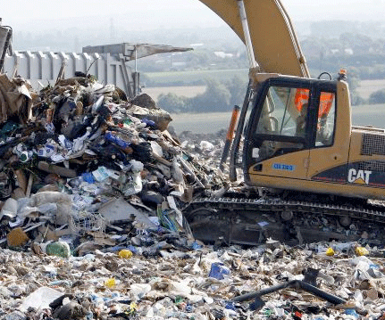
It’s up to you!
When you throw something away, you have a choice
Recycle or Landfill
Notes:
It’s up to you!
Highlight the choices we make every day, whether to recycle or send to landfill:
You finish the orange juice at breakfast. What do you do with the carton? (recycling box)
Your socks have got holes in them. What do you do? (mend them or maybe use them to make a handpuppet. Otherwise put into clothes recycling bank)
You made a mistake and your drawing is spoilt. What do you do with the paper? (recycling box)
Your auntie gives you a new mp3 player. What do you do with your old one? (charity shop, or small electricals part of your local recycling centre)
You're getting a new mattress. What do you do with your old mattress? (landfill)

Slide 12
It’s up to you!
You finish the orange juice at breakfast. What do you do with the carton? (recycling box)
Your socks have got holes in them. What do you do? (mend them or maybe use them to make a hand puppet. Otherwise put into clothes recycling bank)
You made a mistake and your drawing is spoilt. What do you do with the paper? (recycling box)
Your auntie gives you a new mp3 player. What do you do with your old one? (charity shop, or small electricals part of your local recycling centre)
You're getting a new mattress. What do you do with your old mattress? (landfill)

Slide 13
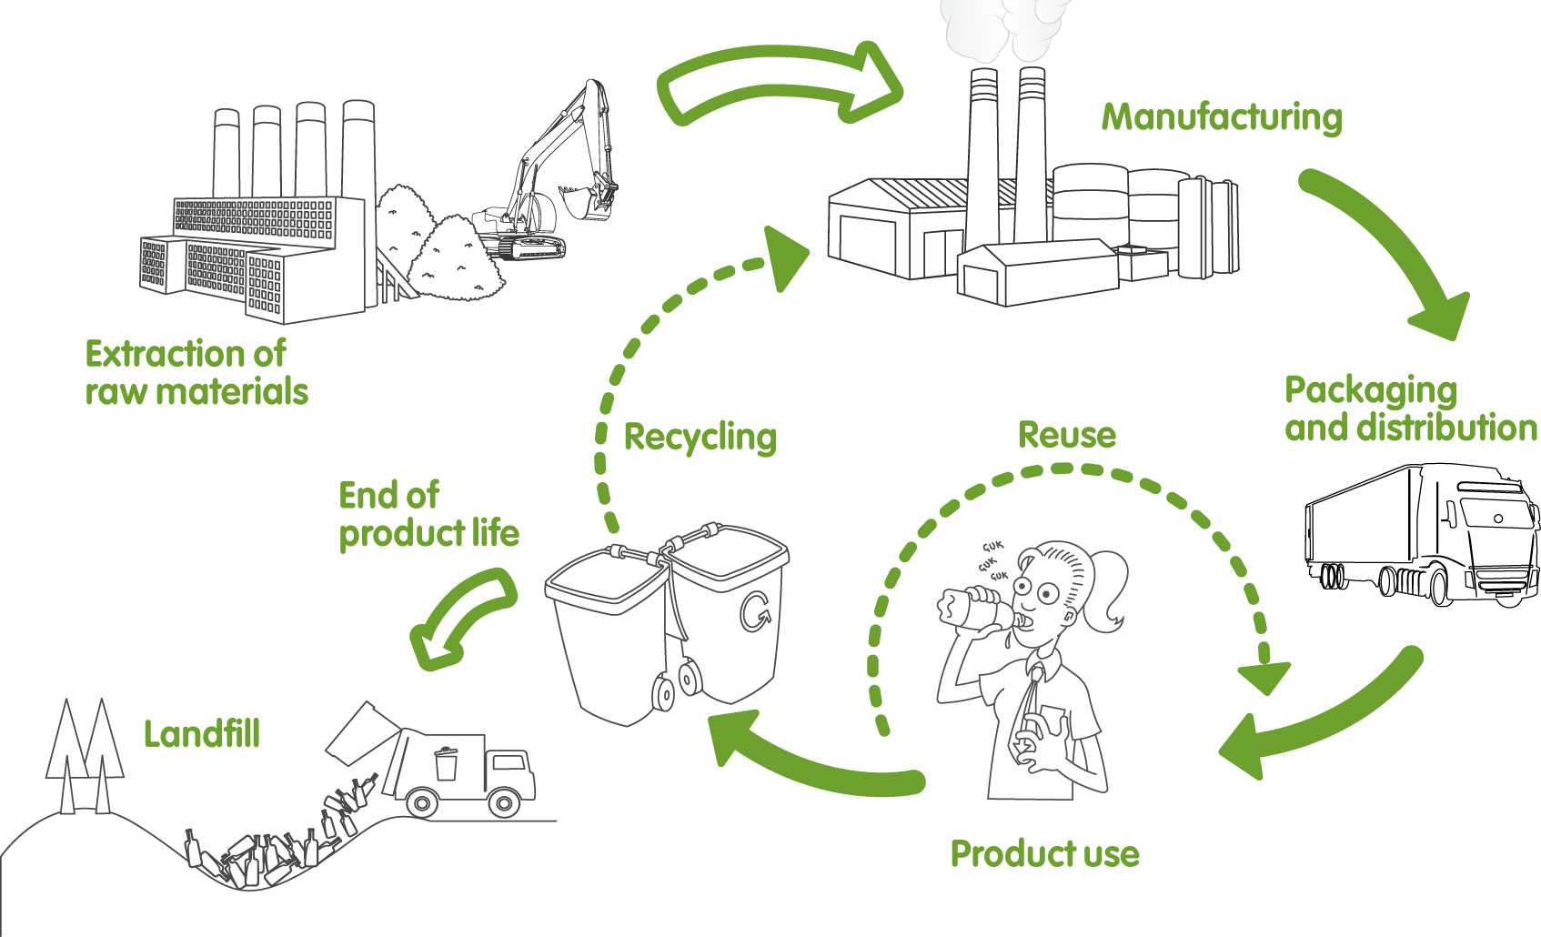
What happens to our waste?
Notes:
What happens to waste?
Let's think about a plastic bottle with juice in your lunchbox. The plastic in this sort of bottle is usually made by a process that uses crude oil.
Once the plastic is made, it shaped into a bottle and filled with juice.
It is packed up and stored in a warehouse, then sent (probably by road) to a shop or supermarket.
You buy it, and drink the juice.
Now you decide:
Reuse it for another drink, maybe fill it with water?
OR put it into the recycling bin?
OR put it into the dustbin?
If you reuse it or recycle it, it carries on being useful. Throw it in the bin and it will end up in landfill.

Slide 14
What happens to waste?
Let's think about a plastic bottle with juice in your lunchbox. The plastic in this sort of bottle is usually made by a process that uses crude oil.
Once the plastic is made, it shaped into a bottle and filled with juice.
It is packed up and stored in a warehouse, then sent (probably by road) to a shop or supermarket.
You buy it, and drink the juice.
Now you decide:
Reuse it for another drink, maybe fill it with water?
OR put it into the recycling bin?
OR put it into the dustbin?
If you reuse it or recycle it, it carries on being useful. Throw it in the bin and it will end up in landfill.

Slide 15
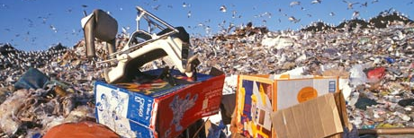
What is landfill?
Big holes in the ground – they’re filling up fast!
What happens to waste that goes to landfill?
Notes:
What is landfill?
Landfill sites are big holes in the ground where we dump the rubbish that we don't recycle.
The landfill sites we are using now are filling up fast. People don't like living near landfill sites, and there is not enough land to keep creating more and more landfill sites just because we have too much rubbish.
What happens to rubbish in a landfill site?
A lot of the rubbish that goes into these landfill sites will rot and give off gases called methane and carbon dioxide (CO2) that are bad for the environment.
Other waste will not rot, just remain in the ground for a very long time.
A glass bottle that ends up in landfill will still be there in a million years' time... and it could have been recycled!
Harmful liquid wastes must be collected and processed to protect the ground around the site.
In some cases, landfill gases are collected and burned to produce energy.

Slide 16
What is landfill?
Landfill sites are big holes in the ground where we dump the rubbish that we don't recycle.
The landfill sites we are using now are filling up fast. People don't like living near landfill sites, and there is not enough land to keep creating more and more landfill sites just because we have too much rubbish.
What happens to rubbish in a landfill site?
A lot of the rubbish that goes into these landfill sites will rot and give off gases called methane and carbon dioxide (CO2) that are bad for the environment.
Other waste will not rot, just remain in the ground for a very long time.
A glass bottle that ends up in landfill will still be there in a million years' time... and it could have been recycled!
Harmful liquid wastes must be collected and processed to protect the ground around the site.
In some cases, landfill gases are collected and burned to produce energy.

Slide 17
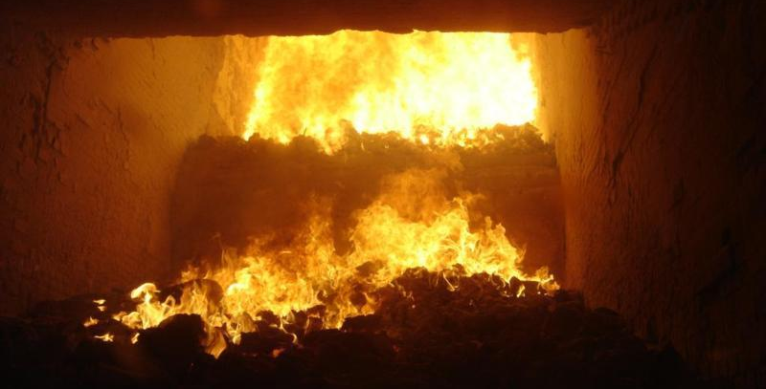
Energy from waste
Notes:
Energy from waste
Burning waste can recover substantial amounts of energy
At the end of the burning process, the volume of waste is much smaller and so the final amount that goes to landfill is a fraction of the original.
When waste is burnt at high temperatures, it produces heat which can be converted to electricity.
Burning waste can give off harmful gases.
To protect health, there are strict guidelines about emissions from plants that burn waste.

Slide 18
Energy from waste
Burning waste can recover substantial amounts of energy
At the end of the burning process, the volume of waste is much smaller and so the final amount that goes to landfill is a fraction of the original.
When waste is burnt at high temperatures, it produces heat which can be converted to electricity.
Burning waste can give off harmful gases.
To protect health, there are strict guidelines about emissions from plants that burn waste.

Slide 19
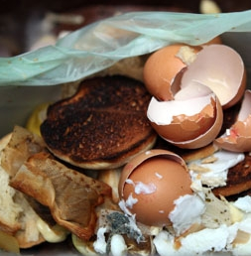
Incredible… but true
We all waste food.
Did you know that in one year, every one of us throws away about 70 kg of food on average?
What is that equivalent to?
That's equivalent to the weight of an average adult.
Most of the food we throw away could have been eaten
What do you think is the main reason for throwing away food?
Notes:
Incredible but true
Every year every one of us throws away about 70 kg of food - that's equivalent to the weight of an average adult.
The main reason we throw away food: it was left on the plate after a meal (in one year, the UK threw away 1,225,700 tonnes of food, worth £3.3 billion) Source: Wrap report – Food Waste in schools
This study suggests that over a school year (40 weeks) a total of:
55,408 tonnes of food waste is generated by primary schools in England - that’s 72 grams per pupil per day
24,974 tonnes by secondary schools - that’s 42 grams per pupil per day
that's a total food waste weight of 80,382 tonnes.
The majority of food waste in both secondary (77%) and primary (78%) schools was found to be avoidable.
http://www.wrap.org.uk/sites/files/wrap/Food%20Waste%20in%20Schools%20Summary%20Report.pdf

Slide 20
The main reason we throw away food: it was left on the plate after a meal (in one year, the UK threw away 1,225,700 tonnes of food, worth £3.3 billion) Source: Wrap report – Food Waste in schools
This study suggests that over a school year (40 weeks) a total of:
  55,408 tonnes of food waste is generated by primary schools in England - that’s 72 grams per pupil per day
  24,974 tonnes by secondary schools - that’s 42 grams per pupil per day
  that's a total food waste weight of 80,382 tonnes.
The majority of food waste in both secondary (77%) and primary (78%) schools was found to be avoidable.

Slide 21

We can all make a difference
How do you know something can be recycled?
Notes:
We can all make a difference
How do you know if something can be recycled?
Take a look at these recycling symbols and see if everyone knows what they mean.
What sorts of things can be recycled?
Do you recycle at home?
Does the council collect it or do you take it to a recycling centre?
Do you make your own compost?
Not just rubbish
Have you bought anything that’s been recycled?
You never know what you'll find at a charity shop!
And how about a secondhand bike?

Slide 22
We can all make a difference
How do you know if something can be recycled?
  Take a look at these recycling symbols and see if everyone knows what they mean.
  What sorts of things can be recycled?
  Do you recycle at home?
  Does the council collect it or do you take it to a recycling centre?
  Do you make your own compost?
  Not just rubbish
  Have you bought anything that’s been recycled?
  You never know what you'll find at a charity shop!
  And how about a secondhand bike?

Slide 23
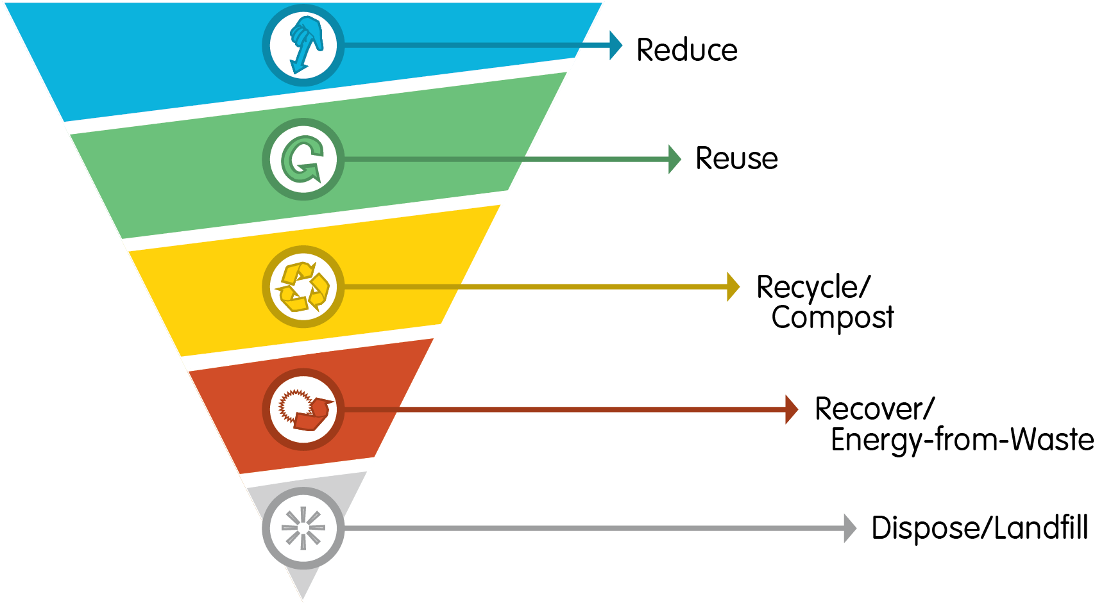
Reduce, reuse, recycle
Notes:
Reduce, reuse, recycle
Reduce
Buy smart. Buy only what you need; use everything that you buy.
Reuse
Get creative! (Remember those socks!)
Recycle
Glass, plastic, paper, cardboard, tins and lots more - they all get a second life when they are recycled!
Clothes to the charity shop
Buy a secondhand bike
Compost
Raw food waste can be composted at home
Most councils collect raw and cooked food waste

Slide 24
Reduce, reuse, recycle
Reduce
Buy smart. Buy only what you need; use everything that you buy.
Reuse
Get creative! (Remember those socks!)
Recycle
Glass, plastic, paper, cardboard, tins and lots more - they all get a second life when they are recycled!
Clothes to the charity shop
Buy a secondhand bike
Compost
Raw food waste can be composted at home
Most councils collect raw and cooked food waste

Slide 25
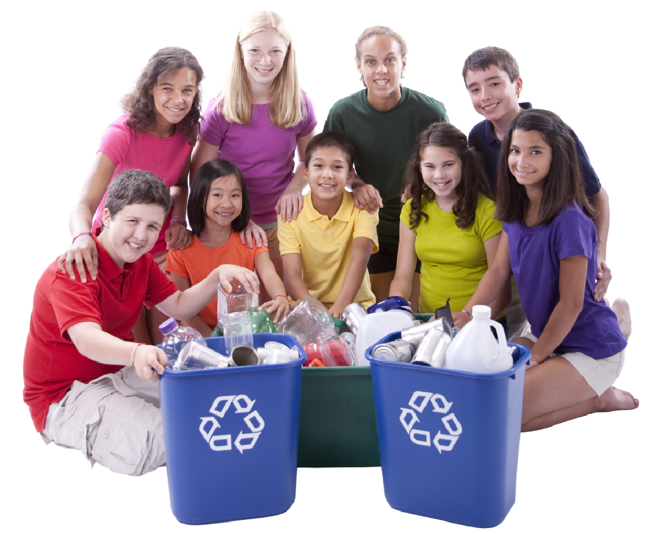
What shall we do at our
school to reduce waste?
Notes:
What shall we do at our school to reduce waste?
What is the majority of the school's waste? (Food? Paper?)
Make a list of the suggestions from the children and staff, on ways to reduce waste.
(Do they mention leaving a clean plate at lunchtime?)
Which ones are new ideas?
What could we improve and how can we do better?

Slide 26
What shall we do at our school to reduce waste?
What is the majority of the school's waste? (Food? Paper?)
Make a list of the suggestions on ways to reduce waste.

Slide 27

Notes:
Find more supporting resources on waste at www.jointhepod.org

