Slide 1
LC: Can I design a postage stamp with a HERO theme?

Slide 2
Honouring our heroes from the coronavirus pandemic

Slide 3

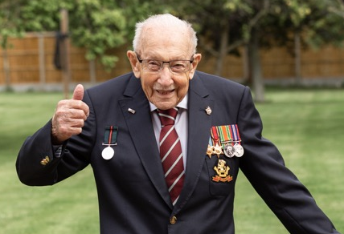
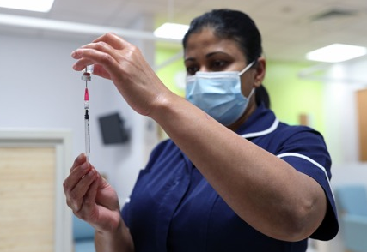
Welcome to the Heroes Stamp
Design Competition
Children aged 4 - 14 years are invited to design a postage stamp.
The stamp design will be based on your hero or heroes of the coronavirus pandemic.
The past year has been very tough for so many people.
There are countless frontline workers, keyworkers and volunteers who have continued to work tirelessly to keep the country moving.

Slide 4

Welcome to the Heroes Stamp
Design Competition
Eight designs will be chosen for this stamp series from Royal Mail.
One of the designs could be yours.
Her Majesty The Queen will approve the winning stamp designs before they are printed and issued.
There are 120 great prizes on offer for area winners and runners up.
Plus, cash prizes for the winning schools too.

Slide 5


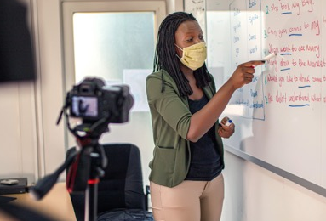
Our Heroes
Have a think about the heroes over the past year.
Which hero or heroes will you honour on your stamp?
The design is completely your choice, but here are some ideas to get you started:-
Captain Sir Tom Moore
NHS staff
Teachers

Slide 6
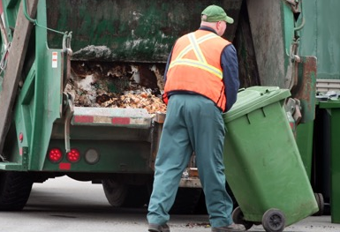
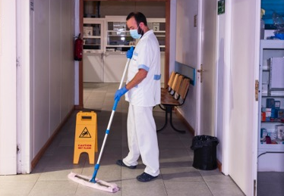
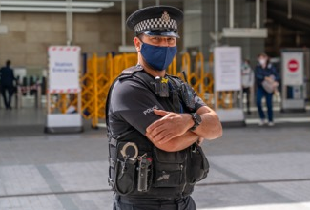
Our Heroes
What about the following groups of people working on the front line?
Refuse collectors
Cleaning staff
Emergency services

Slide 7
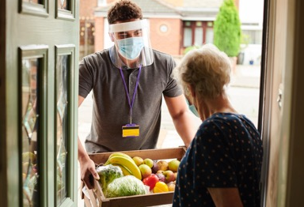
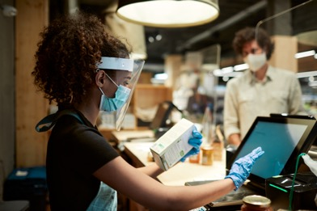
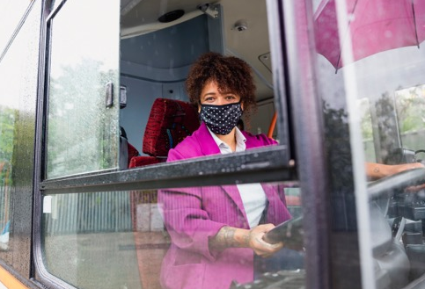
Our Heroes
Or these groups of people?
Delivery drivers
Supermarket workers
Public transport workers

Slide 8
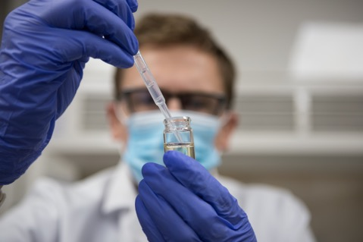
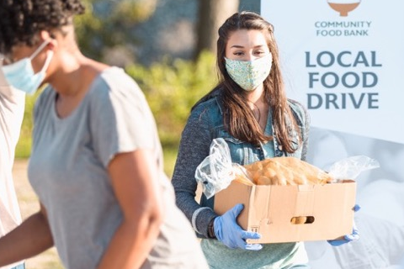
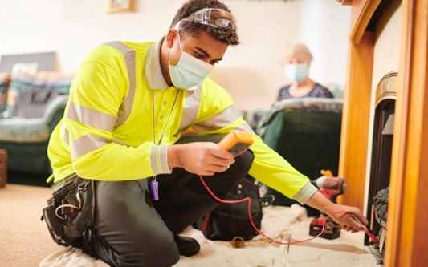
Our Heroes
Many other groups of people such as vaccine scientists, military personnel and food bank volunteers have also worked non-stop to keep the country moving.

Slide 9
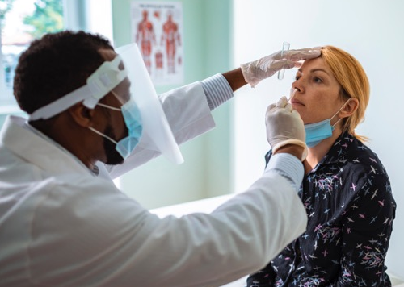
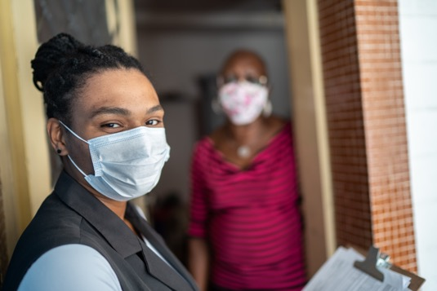
Our Heroes
Can you think of other people?
Discuss these heroes in class and have a think about who you’d like to design on your stamp.
There will be eight different stamps in the set, so let’s consider a range of heroes to honour.

Slide 10

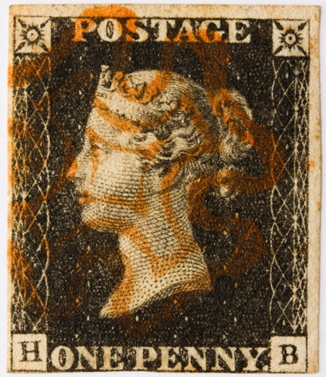
Royal Mail
Did you know?
The UK is the only country to omit its name
on postage stamps, using instead the reigning monarch’s head as country identification.
This is because the UK was the first country
to produce postage stamps.
The world’s first adhesive postal stamp, the
Penny Black, launched in 1840.
Royal Mail can trace its origins back over 500 years to 1516.
It is one of the oldest organisations in the world.

Slide 11
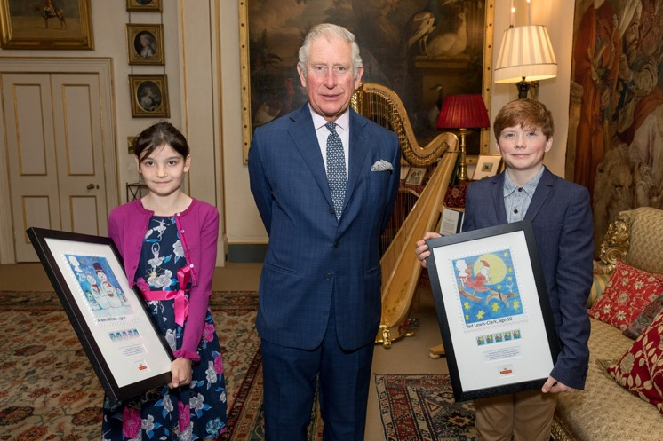
You Can Make History
Eight school children will become part of the history of Royal Mail and of the UK this year.
They will become the designers of stamps that will appear on millions of parcels and letters.
They will follow in the footsteps of Arwen Wilson and Ted Lewis-Clark, the winners of the last children’s stamp design competition in 2017.

Slide 12
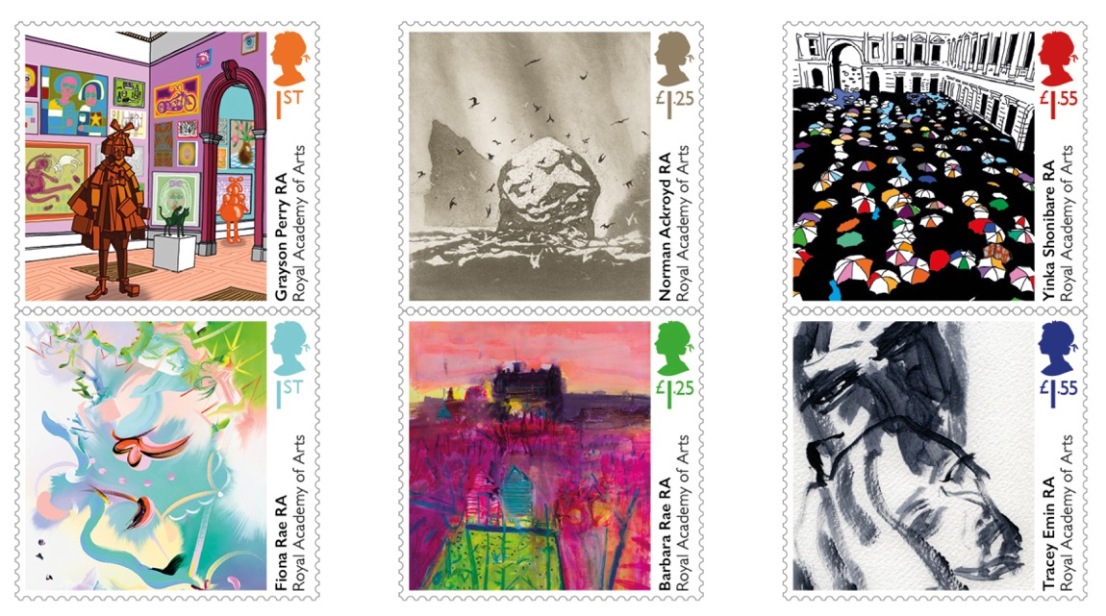
Stamp Designing
Being a stamp designer is a very skilled job.
One of the jobs of a stamp designer is to reduce the size of a picture to fit the stamp.
When designing your stamp, have a think about what kind of image of your hero or heroes would make a good miniature design for a stamp.

Slide 13

Stamp Designing
Take into consideration the thought process of designing in miniature, as it is not always just a case of taking a big design and making it small.
How would your designs work best in miniature? The final stamps produced will be approx. 3.7cm wide x 3.5 cm high.
We’ve provided a few tips and guidelines on the following slide.

Slide 14
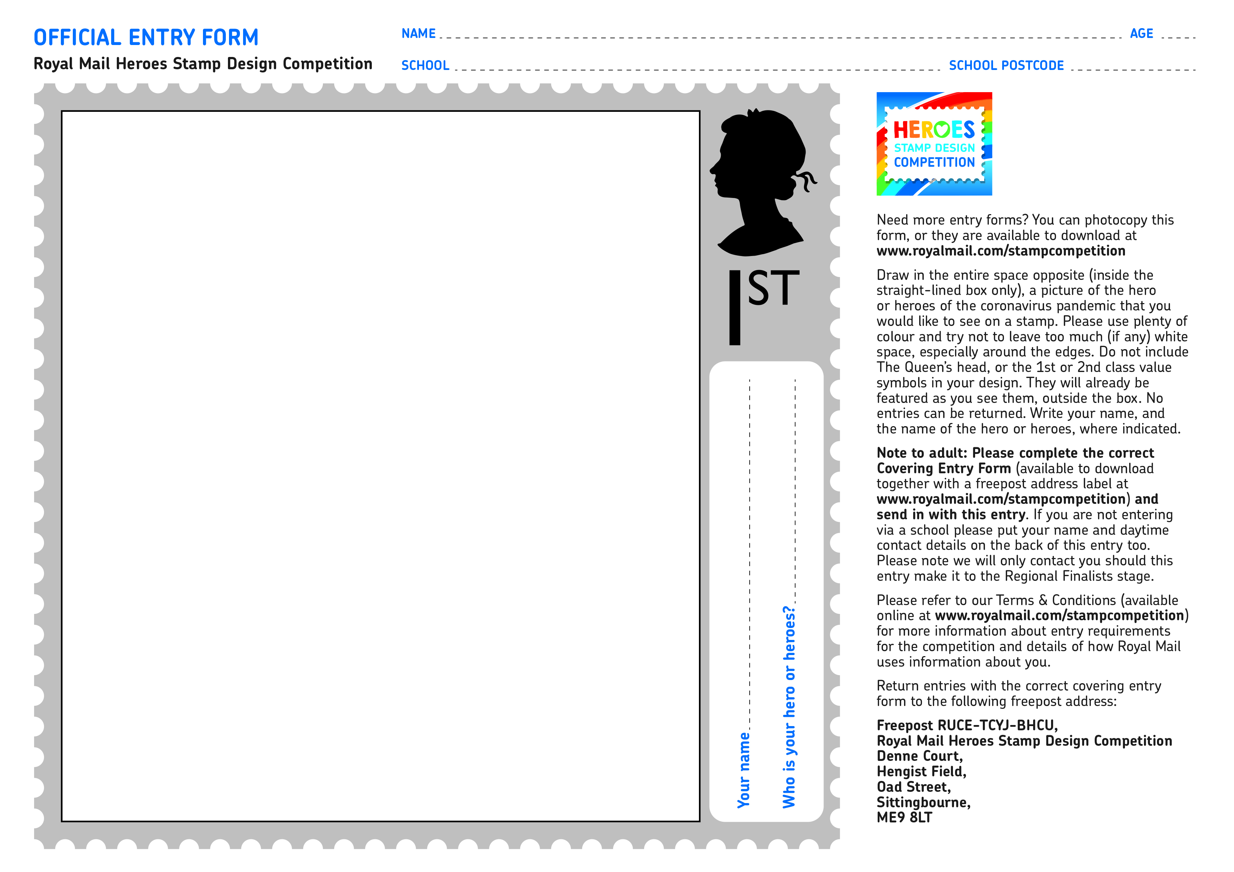
Things to consider
Here are a few things to consider when designing your stamp:-
Your stamp design must be drawn on the official competition entry form which your teacher will give you.
Your design must be your own original work.
Drawings must be flat, so please don’t stick any materials or textures
to your design.

Slide 15
Things to consider
Other things to consider when designing your stamp:-
Please use lots of colour (no black and white images) and use as much of the white space in the solid lined box, in your design as possible. Please avoid using fluorescent inks or highlighter pens.
Please do NOT draw The Queen’s silhouette or the 1st symbol, as these are already shown on your entry form template.

Slide 16
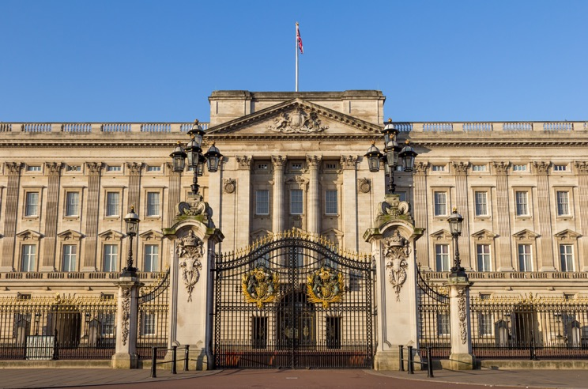
Good Luck
Before the winning designs are sent to print, each of them will need to be approved by Her Majesty The Queen.
The closing date for the competition
is Friday 28th May 2021.
Please have a think about who are your hero or heroes of the coronavirus pandemic and ask your teacher, or parent, for one of the official entry forms. You’re then ready to start designing!
We can’t wait to see all of the amazing designs from talented children across the country.
Good Luck!

Slide 17
Thank you

