Slide 1
LC: Can I understand how temperatures vary across the world?
Monday 18th January

Slide 2

What is temperature?
Can you explain what temperature means?

Slide 3
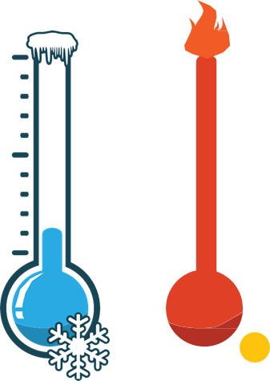
What is temperature?
Temperature is how hot or cold something is.
Temperature is measure in degrees Celsius. This is shortened to ºC
Did you know?
Our body temperature is 37ºC
Water boils at 100ºC
Water freezes at 0ºC

Slide 4
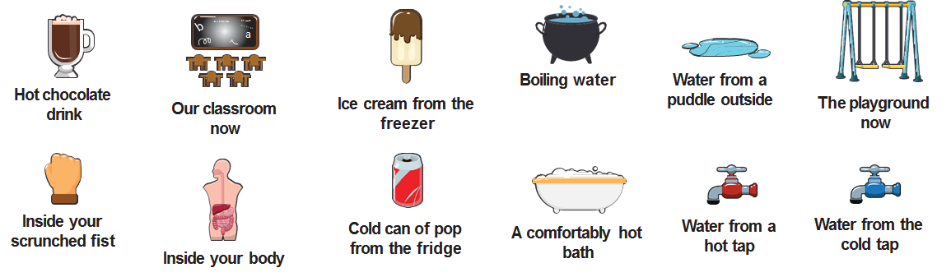
Temperature: Which of these do you think is the hottest? Which do you think is the coldest?
Mini Task
With a partner, put them in order from hottest to coldest.

Slide 5
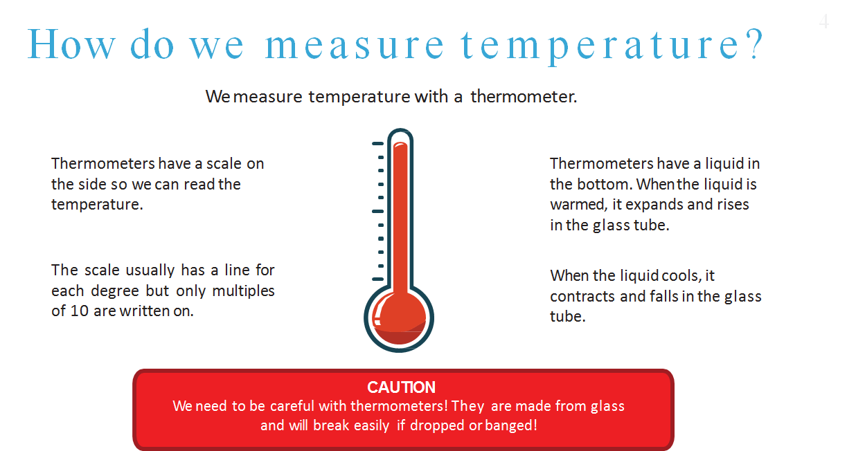
Mini Task
With a partner, put them in order from hottest to coldest on a whiteboardMini Task
With a partner, put them in order from hottest to coldest on a whiteboard

Slide 6
What is day and night?
Daytime is when you can see the sun from where you are, and its light and heat can reach you. Night time is when the sun is on the other side of the Earth from you, and its light and heat don’t get to you.
We get day and night because the Earth spins (or rotates) on an imaginary line called its axis and different parts of the planet are facing towards the Sun or away from it.
It takes 24 hours for the world to turn all the way around, and we call this a day. Over a year, the length of the daytime in the part of the Earth where you live changes. Days are longer in the summer and shorter in the winter.

Slide 7
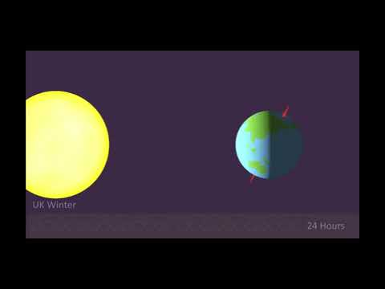
What is day and night?

Slide 8
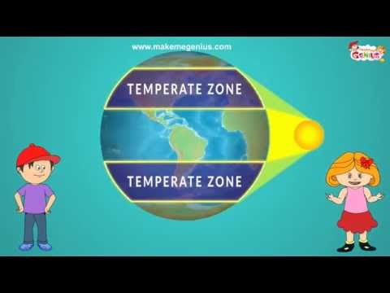
Climate
Zones

