Slide 1
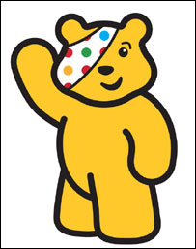
Children in Need
What is it all about?

Slide 2

So what is it all about?
Children in Need is a charity that believes every child in the UK should have a childhood which is:
Safe
Happy and Secure
Allows them the chance to reach their potential
There are many children that
do not have these luxuries.
These children need YOUR
support to give them a better
life.

Slide 3
http://www.bbc.co.uk/programmes/b008dk4b/profiles/cin-whoyouhelp-dortonhouse

Slide 4

What happens with the money?
Every penny from the money donated will go towards helping disadvantaged children and young people right here in the UK.

Slide 5
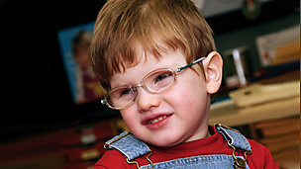
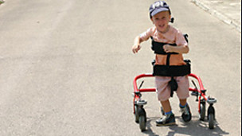
How can we help?

Slide 6
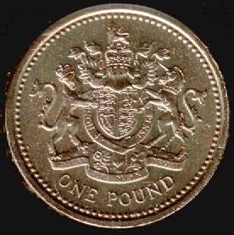
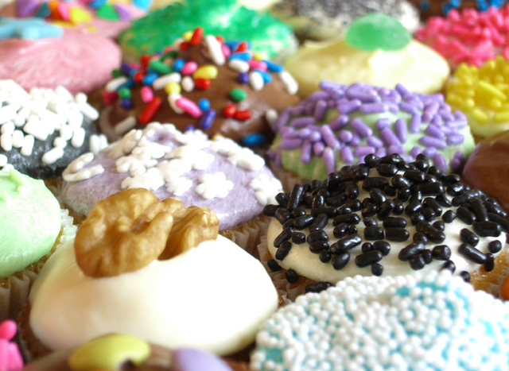
Show your spots on Tuesday 13th November
Bring in £1
Cake sale!

Slide 7

Friday 16th November

Slide 8
Leo, aged 3, has a rare eye disease and could have gone blind. At a regular nursery, he could easily get hurt. His mum found it difficult taking him to a mainstream baby group and remembers thinking he'd never play.
He now goes to Dorton House Nursery for visually impaired children where he can play safely and get help to improve his sight before it's too late.
With your help, BBC Children in Need gave Dorton House Nursery, run by The Royal London Society for Blind People, £7,506 to buy sensory toys for a specialist equipment lending library. Children aged from two to seven attend the project and use the equipment you help fund.

Slide 9
How old were you when you learnt to walk? William was three.
He can’t talk either because he was born with a rare condition, so it’s taking him longer to do all the things that toddlers do. But going to Playskill near his home in Hertfordshire every Friday has made all the difference.
There, he sees specialists who help him learn how to communicate and move. And all the time, William is having fun.
Your money pays for experts who help children like William develop and progress.

