Slide 1
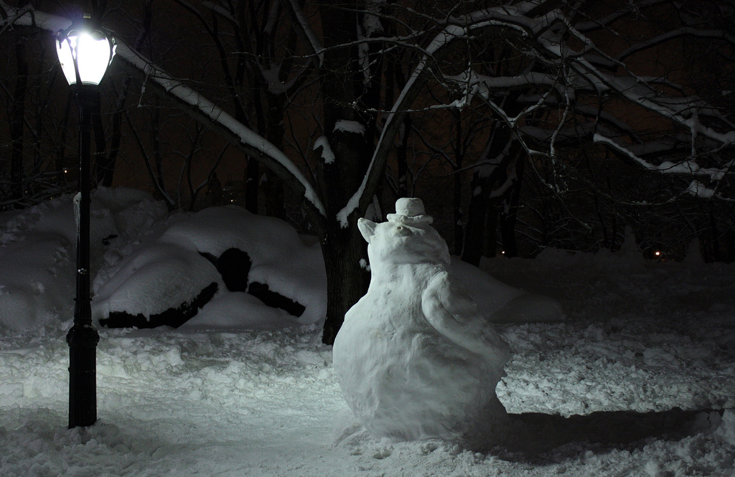
Describe a Setting
Write 5 sentences about:
What you can feel under your feet
What you can see
What you can hear
What the weather is like
Your footprints
Challenge:
Imagine the penguin comes to life. Describe the moment when it realises it can move. Describe it moving gently and carefully at first. Describe what it decides to do.

