Slide 1




The 3s

Slide 2
Aim
I can multiply and divide by 3.
Success Criteria
I can count in 3s.
I can recognise multiples of 3.
I can write multiplication statements for arrays.
I can use arrays to find division facts.
I can use my knowledge of the 3× table to find division facts.
I can solve multiplication and division word problems using these facts.

Slide 3

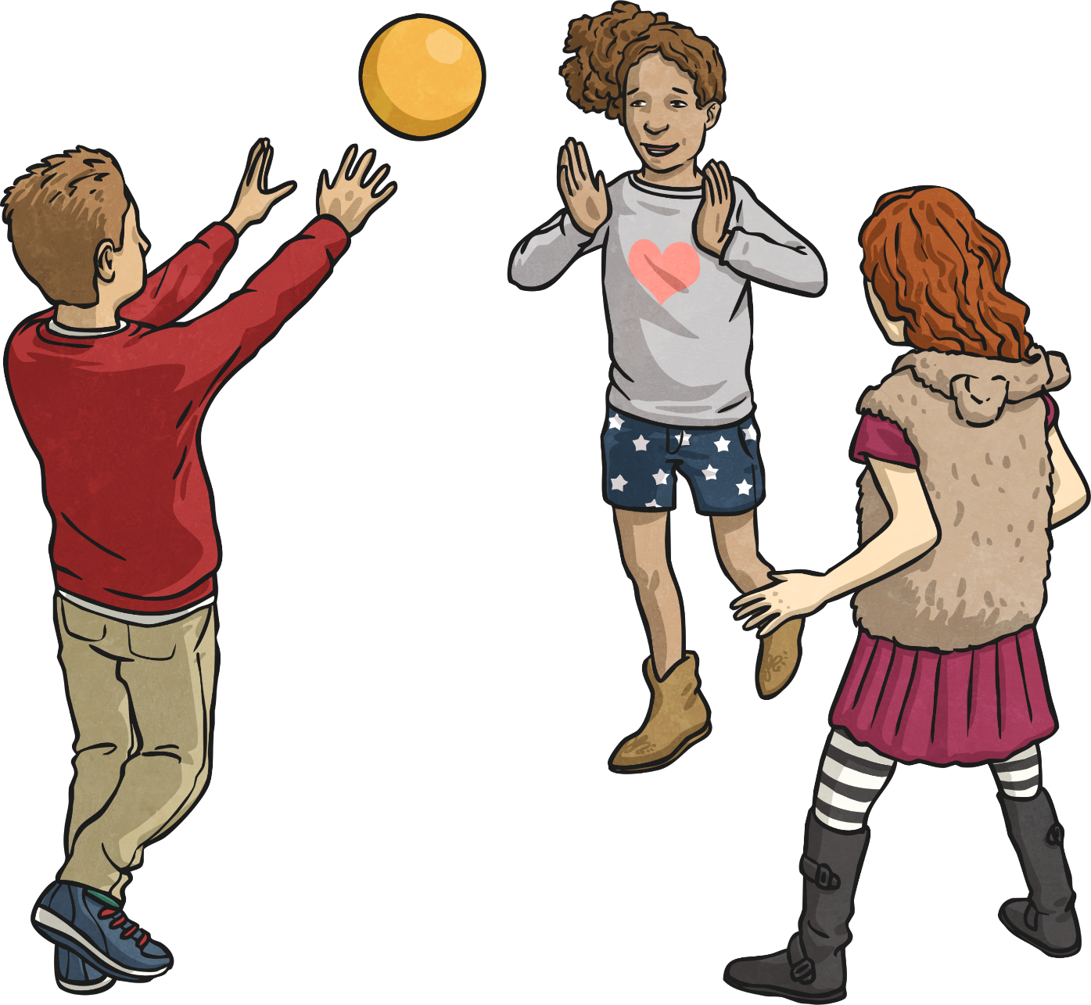
Hot Potato Game
Pass the potato as quickly as you can. It is really hot!

Slide 4


Let’s Count in 3s!

Slide 5
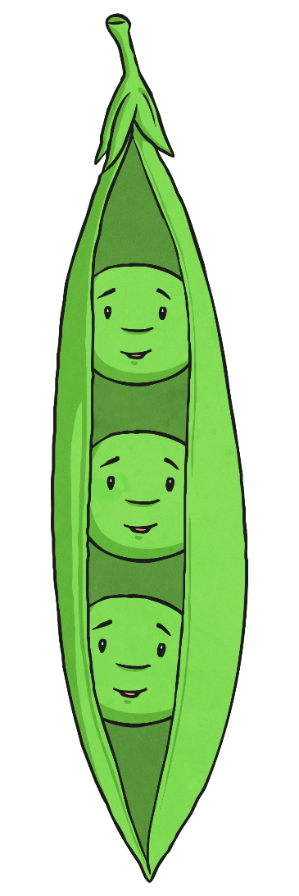

Three Peas Please
How many peas are there in this picture?
How did you count them?

Slide 6

Three Peas Please
Peas like to be in pods. Pea pods can be as big as you like but they must contain the same number of peas in each pod.

Slide 7

Three Peas Please
These 12 peas are in 4 groups of 3
4 × 3 = 12

Slide 8
Three Peas Please
What if we looked at the horizontal groups instead?

Slide 9

Three Peas Please
What if we had pods that held 4 peas?
3 × 4 = 12

Slide 10



Three Peas Please
4 × 3 = 12
3 × 4 = 12
We can write 2 multiplication statements about our group of 12 peas.

Slide 11



Three Peas Please
When we grouped our 12 peas into pods of 3, we had 4 pods.
When we grouped our 12 peas into pods of 4, we had 3 pods.
12 ÷ 3 = 4
12 ÷ 4 = 3
Look carefully at the division statements. Both of our division statements start with the total number of peas, which in this case is 12.

Slide 12
Three Peas Please
We can make 4 number statements about our groups of 12 peas.
3 × 4 = 12
4 × 3 = 12
12 ÷ 4 = 3
12 ÷ 3 = 4

Slide 13
Three Peas Please
Can you write 2 multiplication and 2 division statements
about these peas?

Slide 14
Three Peas Please
How about these? How many facts can you write?
There are only 2 facts for this set of peas. Why is this?
9 is a square number

Slide 15

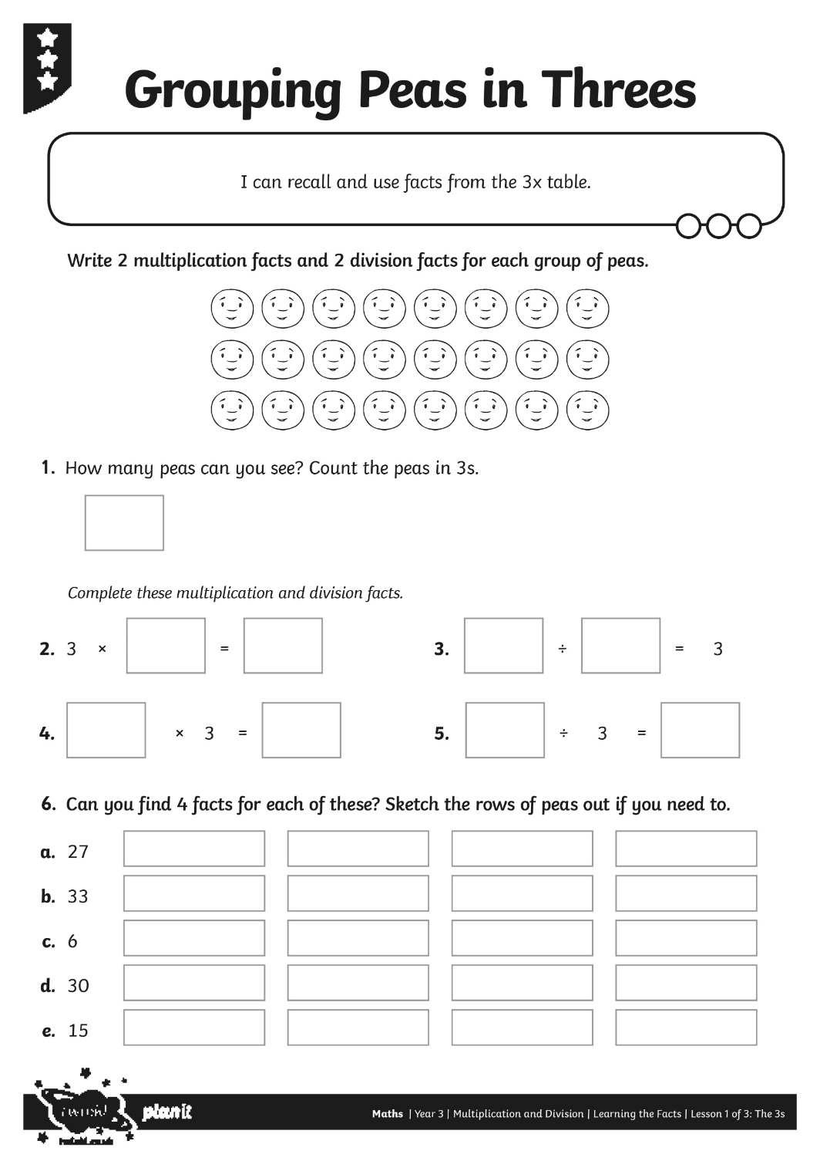
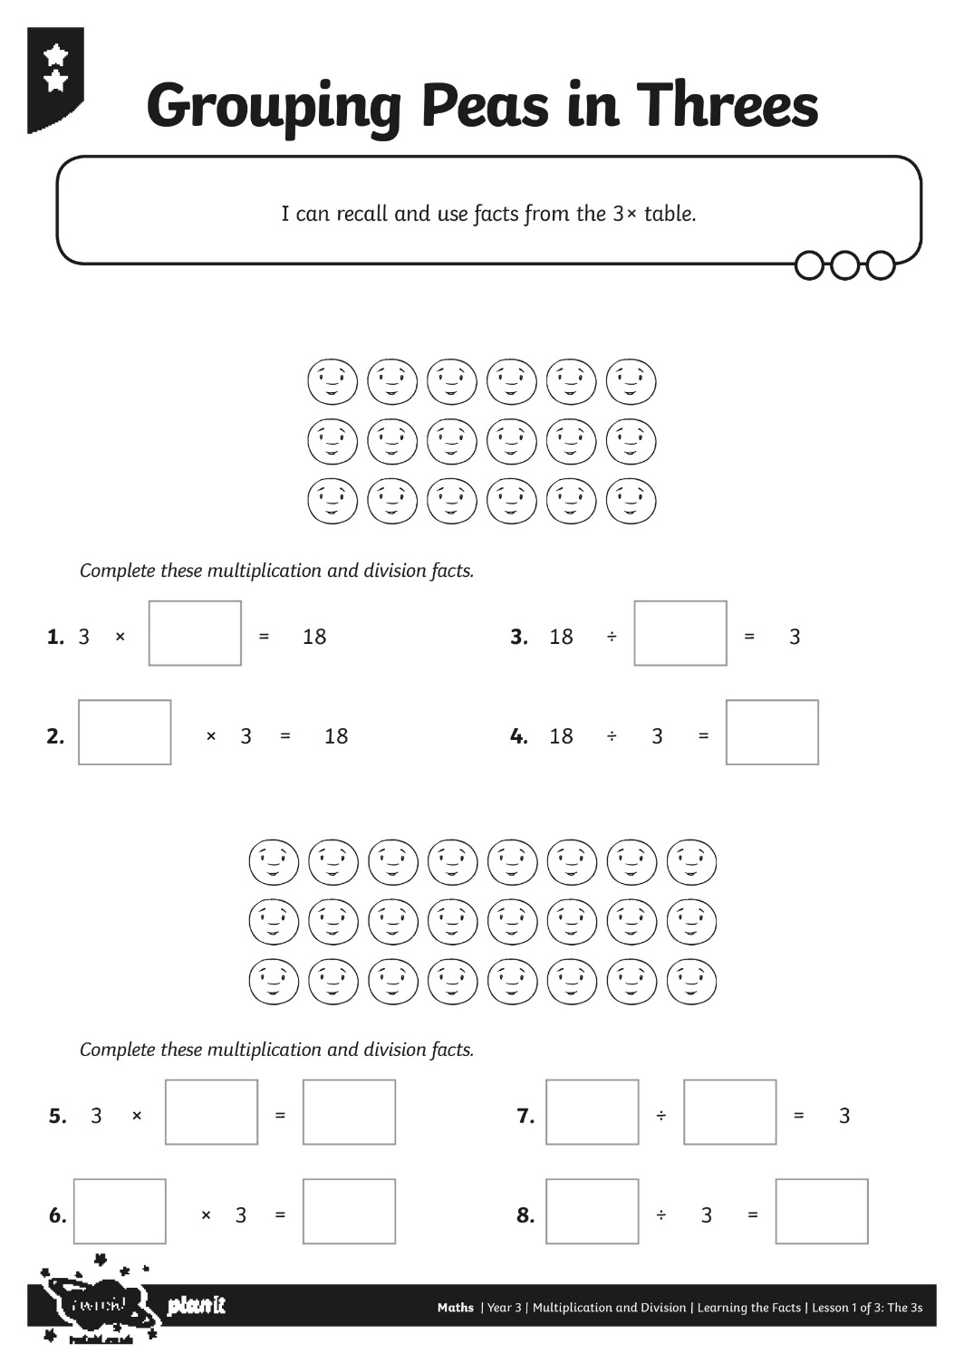
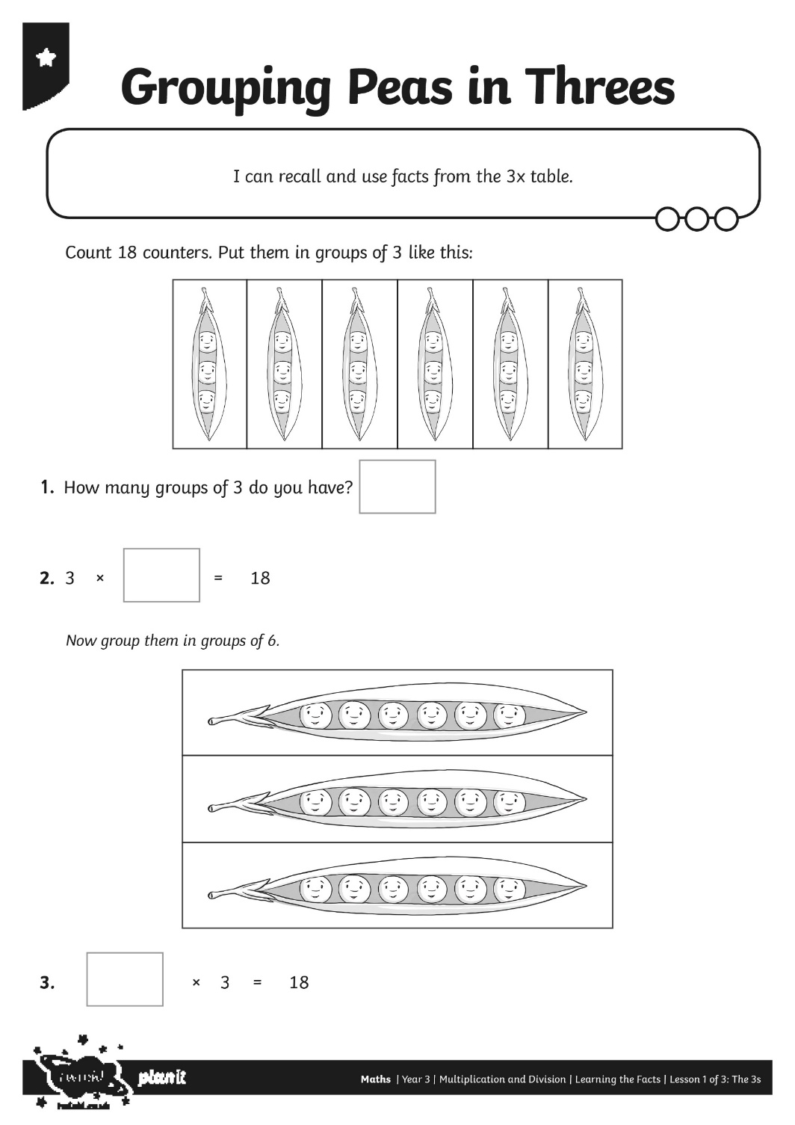
The 3s Activity

Slide 16
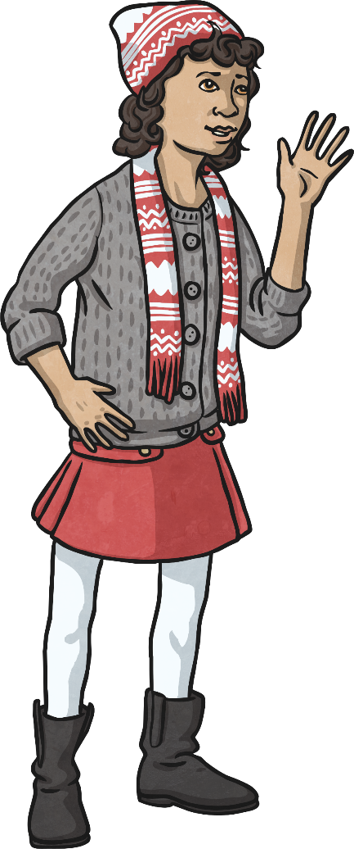
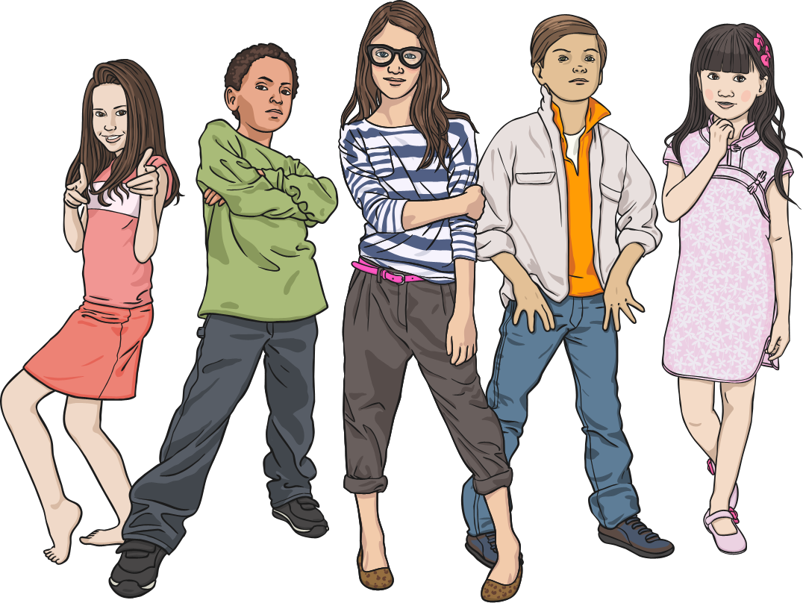
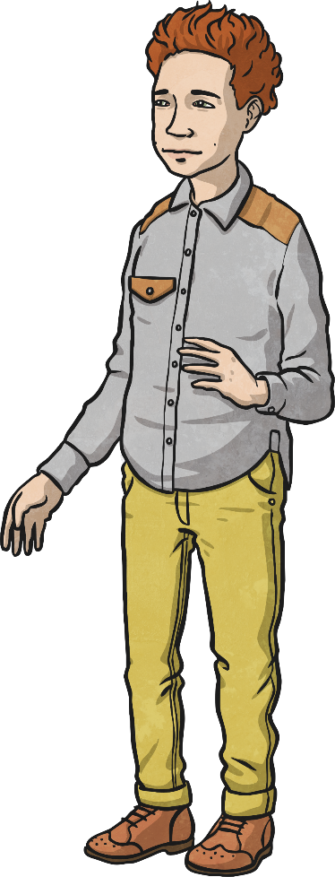

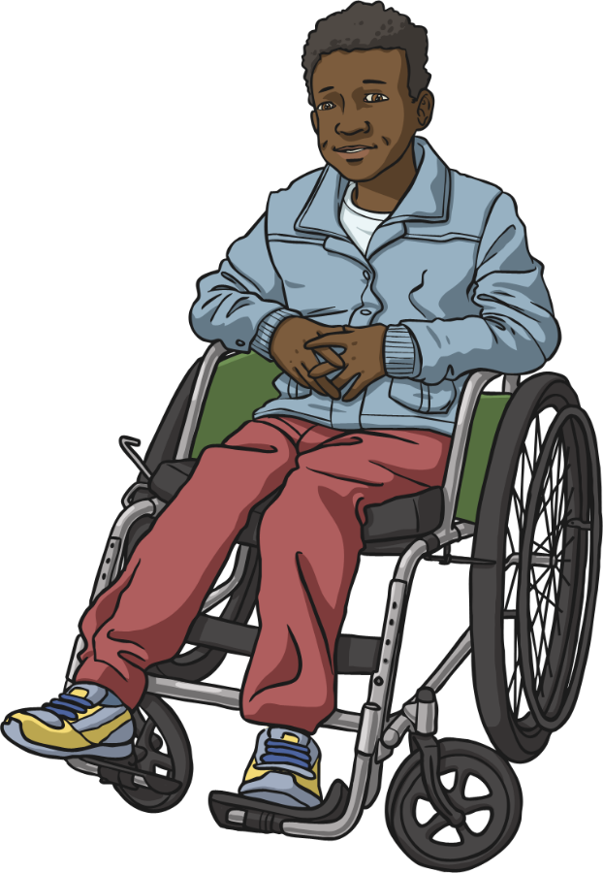
Teams of 3
Can we make an array?
What are the multiplication and division facts?

