Slide 1
Example of a Haiku
Snowman in a field listening to the raindrops wishing him farewell
Roger McGough

Slide 2
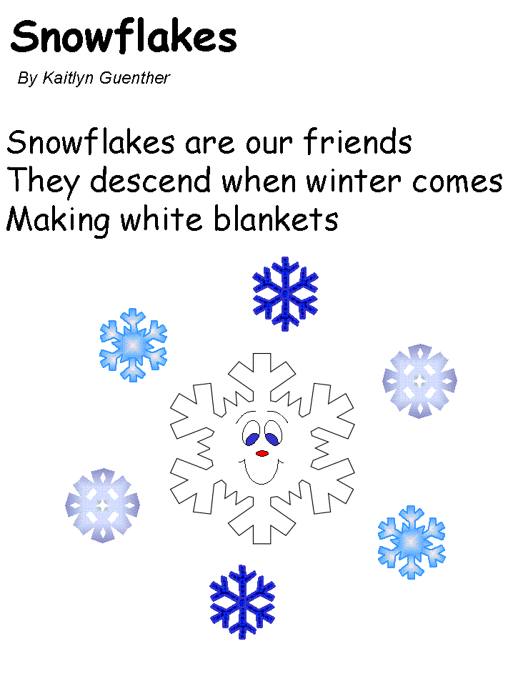

Slide 3
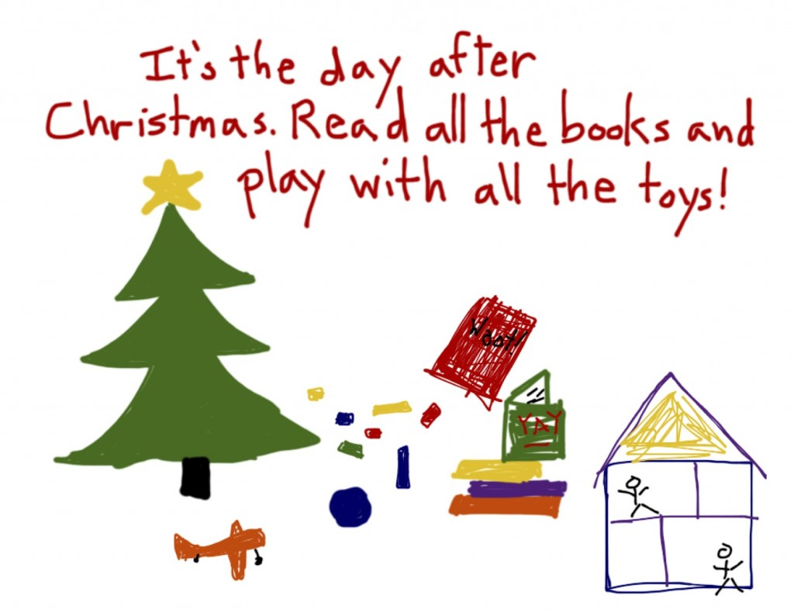

Slide 4


