Slide 2
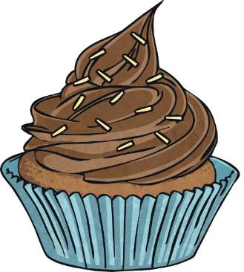
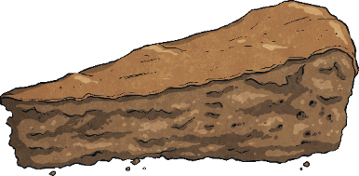
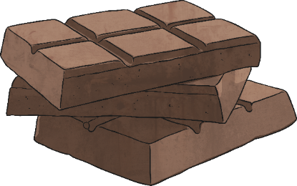
What Is Mardi Gras?
Mardi Gras is traditionally a day people indulge in rich food and celebration before Lent. Lent is a 40-day time period in which Christians fast and praise in preparation for Easter.

Slide 3
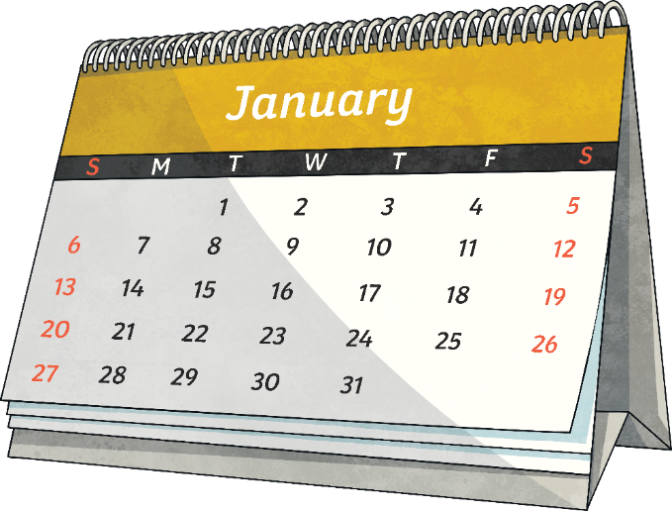
When Is Mardi Gras?
The Mardi Gras celebration is the last day of the Carnival season and the day before Ash Wednesday. The Carnival season begins on January 6th.
During this time, there are parades and balls.

Slide 4
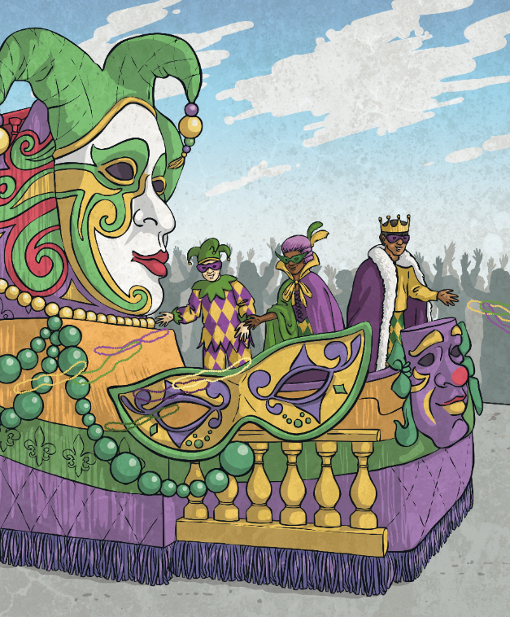
What Is Carnival?
Carnival is a season of celebration before the religious event of Lent.
During this time, there are parades and balls.
People spend time indulging in good food and drinks.
Mardi Gras is the last day of Carnival.

Slide 5
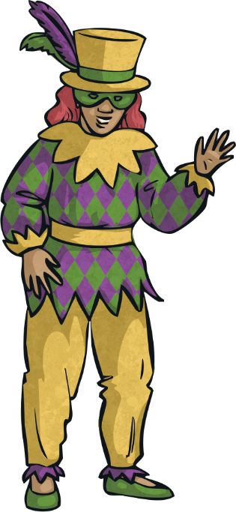
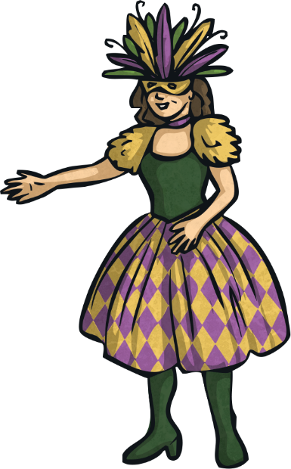
When Was the First American Mardi Gras?
There is a debate about when the first American Mardi Gras celebration occurred.
Many historians believe it occurred on March 3, 1699.
Others believe it occurred in 1703.

Slide 6
The Many Name of Mardi Gras
Mardi Gras is also referred to as…
Fat Tuesday
Shrove Tuesday
Pancake Day

Slide 7
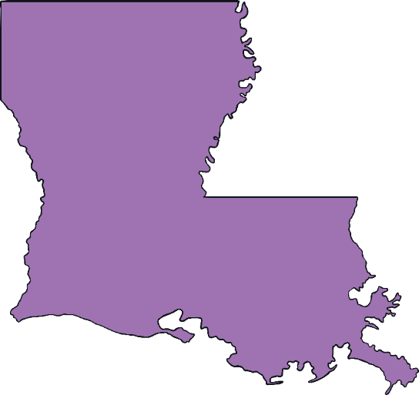
New Orleans, LA
Mardi Gras is celebrated all over the world, but the largest celebration is in New Orleans, Louisiana.
New Orleans
The first Mardi Gras parade was on February 24, 1857 in New Orleans.

Slide 8
Traditional Colors
The traditional symbolic colors of Mardi Gras are purple, green, and gold.
Purple
=
Justice
Green
=
Faith
Gold
=
Power

Slide 9
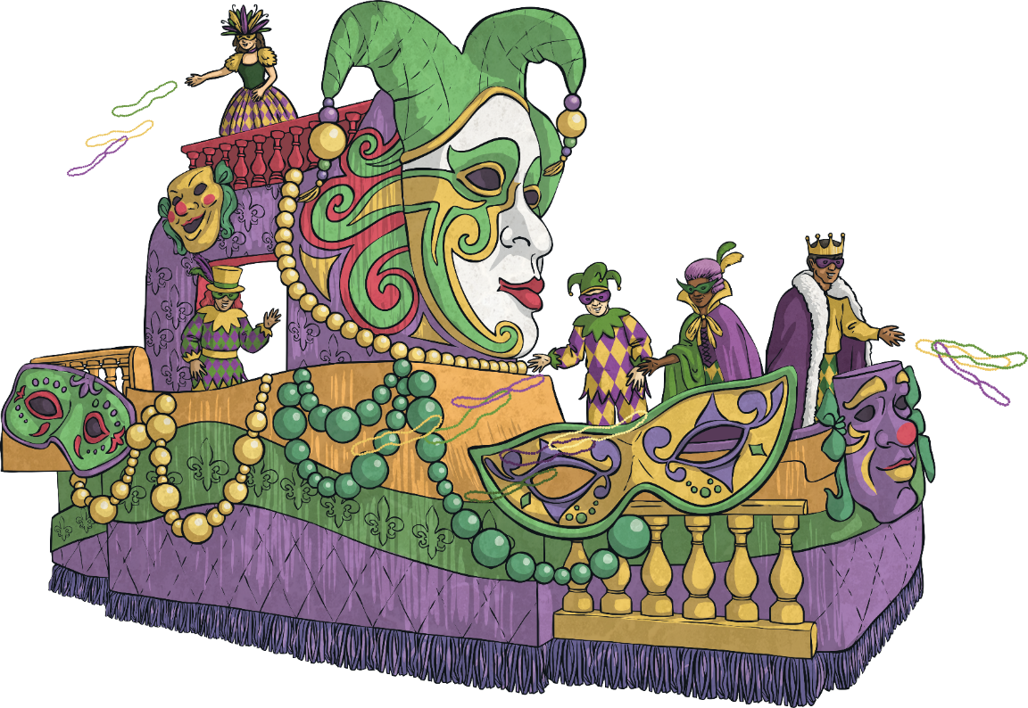
Krewes
Krewes are an important part of Mardi Gras.
Krewes are groups or organizations who come together to host a Mardi Gras ball, ride on a parade float, and participate in social events throughout the year.

Slide 10
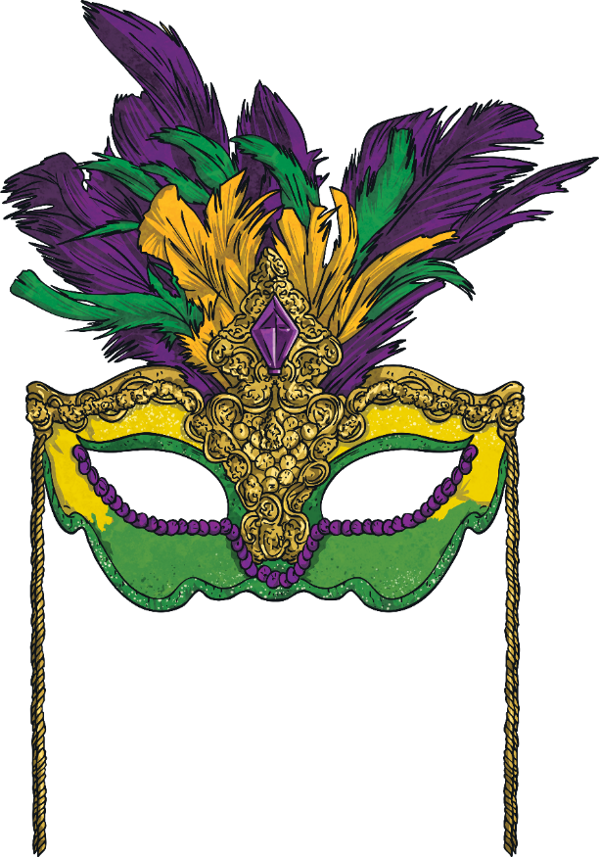
Masks
Masks and costumes are a large part of the Mardi Gras tradition.
It is illegal to ride a Mardi Gras float without a mask!

Slide 11
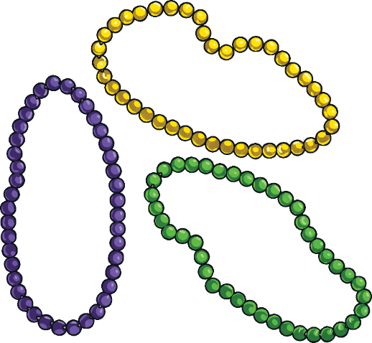
Beads
Beads are a popular Mardi Gras tradition.
The original idea was to pass beads out during the parade to people who exhibited the traits of the three Mardi Gras colors: justice, faith, power.

Slide 12
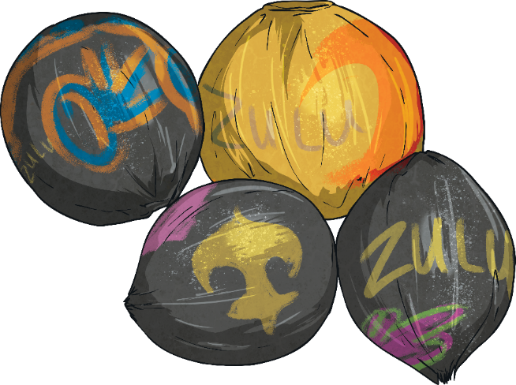
Zulu Coconuts
Zulu coconuts are another popular Mardi Gras tradition.
The coconuts were originally left in their natural state but are now decorated and covered in glitter.

Slide 13
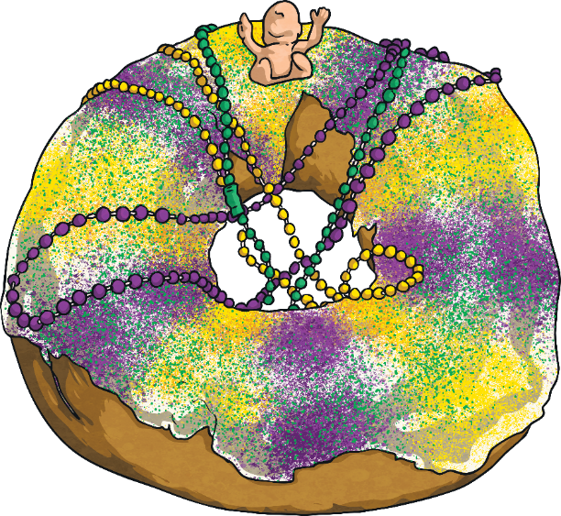
King Cakes
King Cakes are Mardi Gras’s most popular food.
They began as a simple ring
of dough.
The most popular King Cake
now is a braided Danish pastry iced with purple, green, and gold icing.

