Slide 2
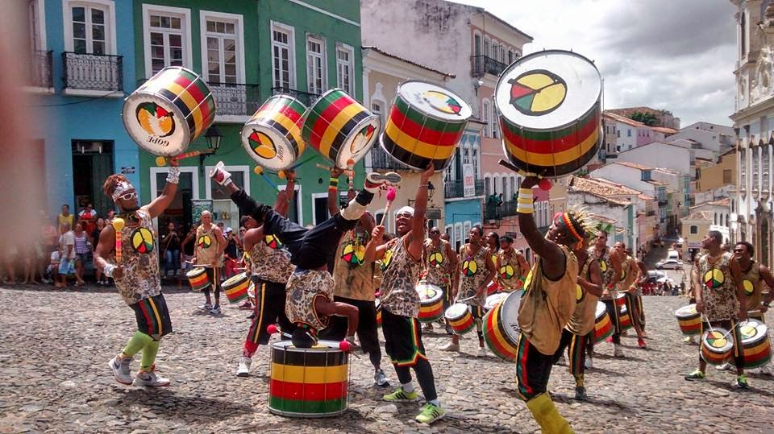
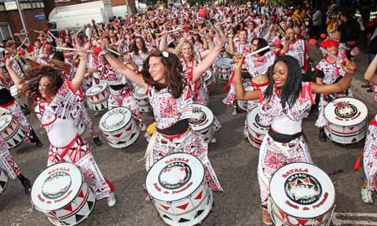
Carnival of Brazil
The Carnival of Brazil is a festival which takes place across the country every year. It starts on the Friday afternoon before Ash Wednesday and ends on Ash Wednesday at midday. This is the beginning of Lent; a Christian festival when Roman Catholics stop eating meat and poultry.
Carnival is a significant holiday in Brazil. Shops and industries close and Brazilians celebrate for almost a week. Celebrations are colourful, energetic and full of Samba music like the one you have been playing today.

Slide 3
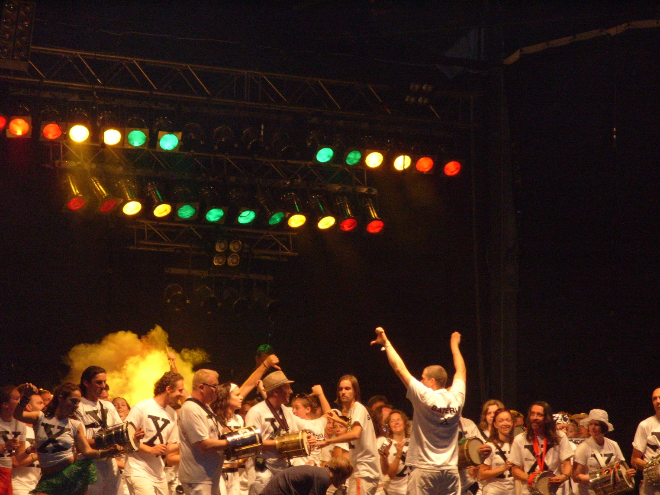

Samba Music
Samba is Brazil's most well-known musical form and most widely played kind of Brazilian music.

Slide 4

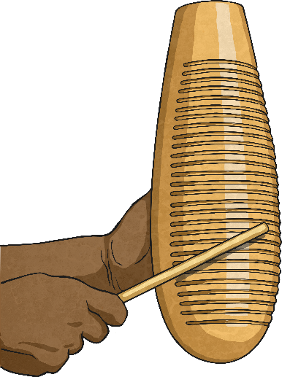
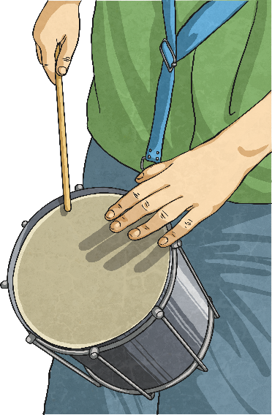
DIY Samba Instruments
Click on the icon below to watch a video about using everyday objects to create instruments for a samba band.
Can you think of other everyday objects which would make good percussion instruments for a Samba band?

Slide 5
https://classroom.thenational.academy/lessons/to-explore-key-characteristics-of-samba-c9k32d
https://www.bbc.co.uk/bitesize/clips/zrjn34j

